Slide 1
The Industrial Ontologies Foundry Core Ontology

Slide 2
Talk overview
IOF Architecture, development principles and release criteria
IOF Core summary and taxonomic overview
IOF Core version highlights
IOF Core 202401 Release – deep dive
Conclusions

Slide 3
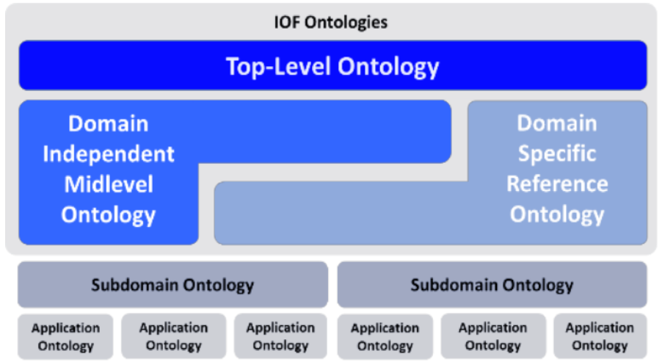
IOF ontology architecture
BFO
IOF Core

Slide 4
WHY BFO?
Demonstrated value for making disparate ontologies or data models within the biological and other domains in an interoperable manner
Compact and explainable
Large community
Well documented and maintained
Already a top-level ontology for various mid-level and domain-specific ontologies
Already a top-level ontology for domain and application ontologies within manufacturing
Became an ISO standard

Slide 5
IOF Core development process
Initial Development Process
Current Development Process
Collect and analyze submissions of terms from a wide array of manufacturing experts
Select terms that are mostly cited across multiple domains of manufacturing
Refine the terms collaboratively between 1) ontology and 2) subject matter experts
Identify new terms that are required for the formalization of existing terms and that are mandated as a basis for a more specialized IOF Ontology
Determine topics of interest from the board and IOF community (external partners and IOF TOB)
Collect sample data and users stories for the topics of interest and create a priority list
Select terms based on user stories, sample data, subject matter expert feedback and literature
Refine the terms collaboratively between 1) ontology and 2) subject matter experts
Identify new terms that are required for the formalization of existing terms
Incorporate terms from IOF domain ontologies that are determined to be cross-cutting

Slide 6
IOF Core Criteria For Release
Terms must be applicable to one or more domains
Annotations must be complete and conform to the established IOF guidelines
Terms must be clear to subject-matter experts
Axioms and natural language must be consistent with common domain usage of terms
Terms must not be redundant
A reasoner (Hermit) must not find any logical consistencies
Competency questions derived from the user stories must be satisfied in SPARQL

Slide 7
IOF Core Summary
Initial, beta version (202205)
Current 2024/01 release
57 OWL classes
1) 20 defined classes
2) 37 primitive classes – 8 classes have only A subclassOf: B as the axiom
38 OWL properties
- 12 non-subproperties of BFO
- 5 non-simple propertie
78 OWL classes
1) 35 defined classes
2) 43 primitive classes – 5 classes have only A subclassOf: B as the axiom
63 OWL properties
- 24 top object properties
- 8 non-simple properties

Slide 8
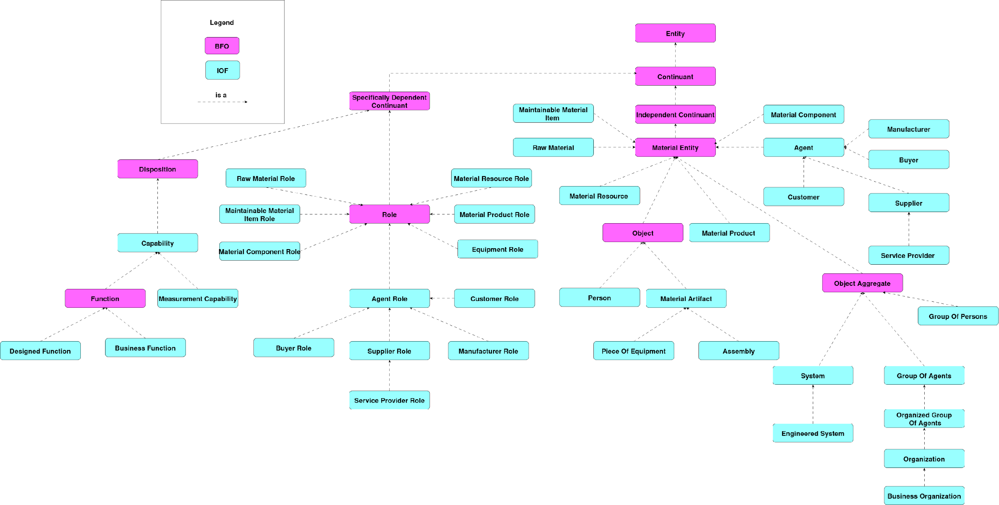
The IOF Core – First half

Slide 9
The IOF Core – Second half

Slide 10
IOF Core Beta highlights
Provided the overall basis for other IOF ontologies (SCO, Maintenance)
Contains key specifications for the industrial area (design, requirement, plan)
Contains fundamental processes for various industrial domains (material location change, business process, manufacturing process)
Contains basic classes to represent man-made entities and organizations (engineered system, material artifact, organization)
Contains multiple roles to account for material entity lifecycle phases (will be discussed further on following slides)

Slide 11
IOF Core 202301 Highlights
Created constructs for representing measurements and measurement process
Created constructs for representing algorithms and their executions
Created provisional definitions for event and state
Created the identifiers class as well as the mapping to external Commons ontologies
Increased the quality and comprehensibility of the annotations

Slide 12
IOF Core version 202401 Summary
Introduced Allen Interval Algebra into the IOF Core
Introduced Gain of Role and Loss of Role processes
Created a guideline for QUDT usage to represent unit-value pairs
Created a mapping to OWL-time
Migrated several constructs from SCO (formely SCRO) to IOF Core

Slide 13
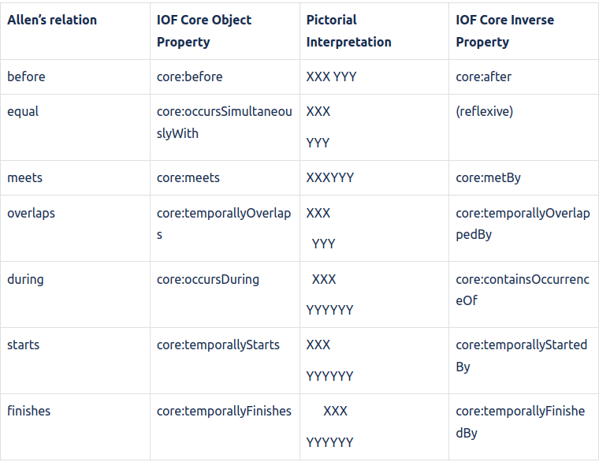
Allen Interval Algebra
Set of properties based on the well established Allen Interval Algebra
Value added: Permits the users to represent temporal ordering between processes and time interval in a more precise and detailed manner.
Example: entire temporal flow of activities necessary to manufacture a particular product

Slide 14
Allen Interval Algebra
Two additional files:
1) SWRL Rules
2) Property Chains
These files allow the users, when using appropriate reasoner to:
1. infer certain Allen Relations just based on time stamps of the interval or process start
2. infer the composition of multiple Allen relations
For detailed hands-on demonstration please join the IOF Core tutorial

Slide 15
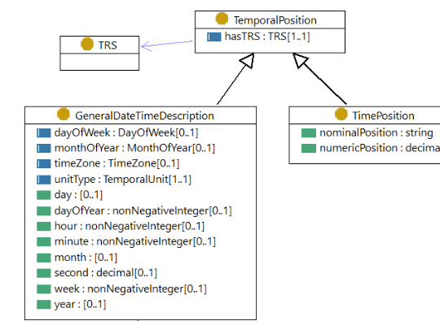
Mapping IOF Core to OWL Time
rdfs:subClassOf
TemporalInstantValueExpression
core:isValueExpressionOfAtAllTimes
Temporal Interval
TemporalDurationValueExpression
owl:equivalentTo
core:isValueExpressionOfAtAllTimes
Temporal Interval

Slide 16
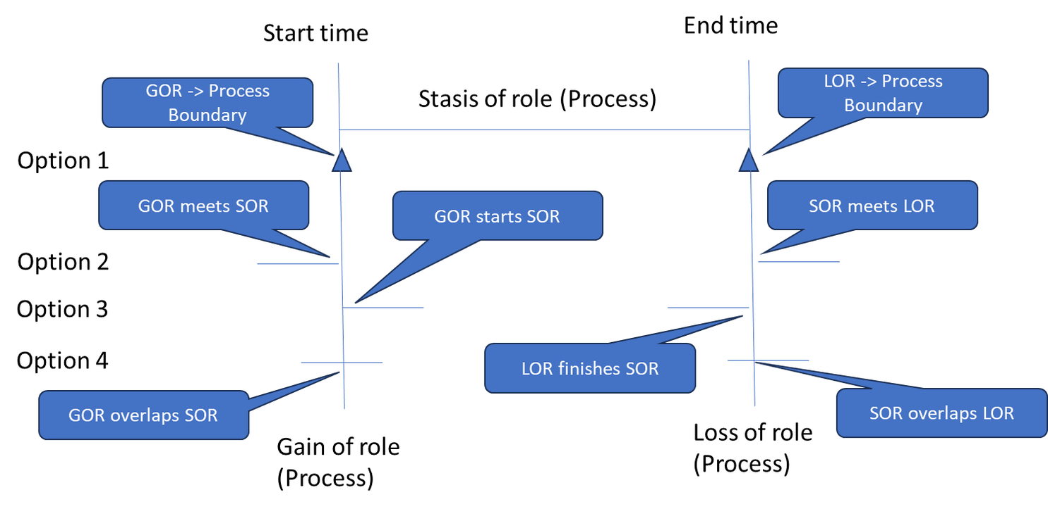
Gain Of Role and Loss Of Role
Two classes asserted under BFO:Process
Value added: these processes allow the users to assert the exact conditions under which a particular entity has acquired a role or when a particular role has been terminated
Examples: employment tracking, change of custody/ownership, different material utilization (product vs raw material)
span of role

Slide 17
Guideline for QUDT utilization with IOF Core
Interim, non-normative guide for using the QUDT ontology suite with IOF ontologies
Value added:
Foundation for consistent unit-value pair representation
Provides patterns how to represent different types of unit-value pairs as well as ranges
Allows flexibility to use other unit sytems with IOF ontologies

Slide 18
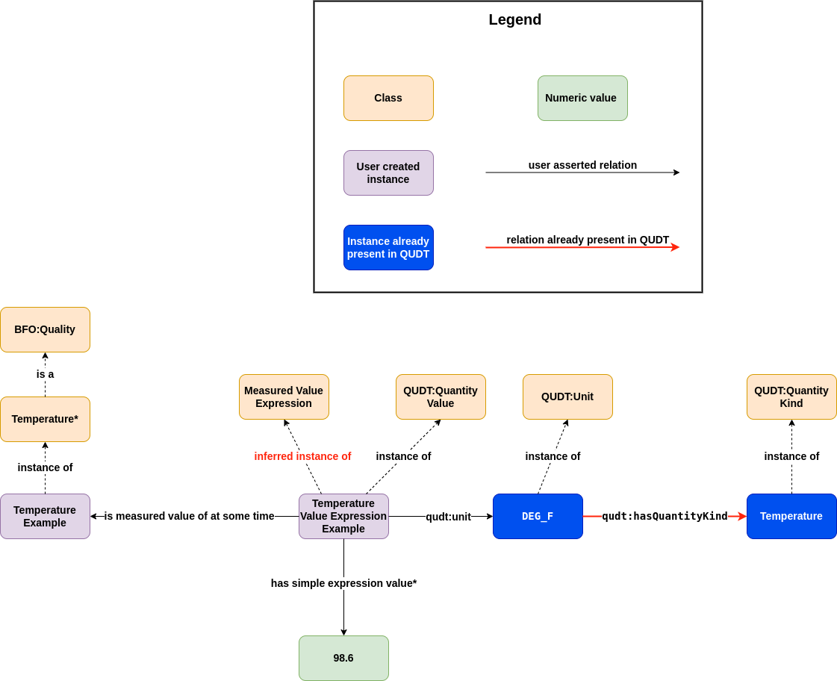
Guideline for QUDT utilization with IOF Core

Slide 19
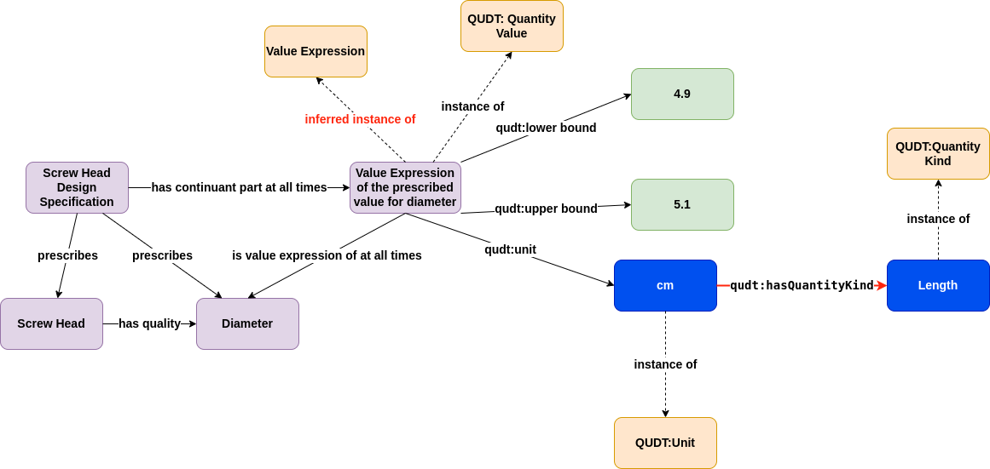
Guideline for QUDT utilization with IOF Core

Slide 20
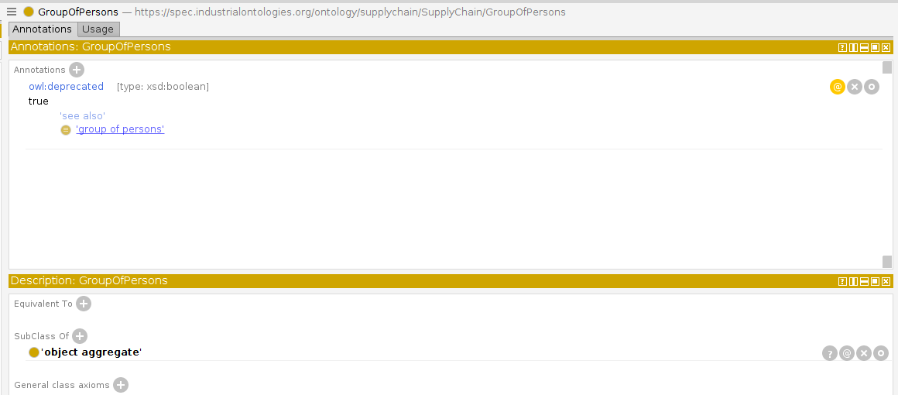
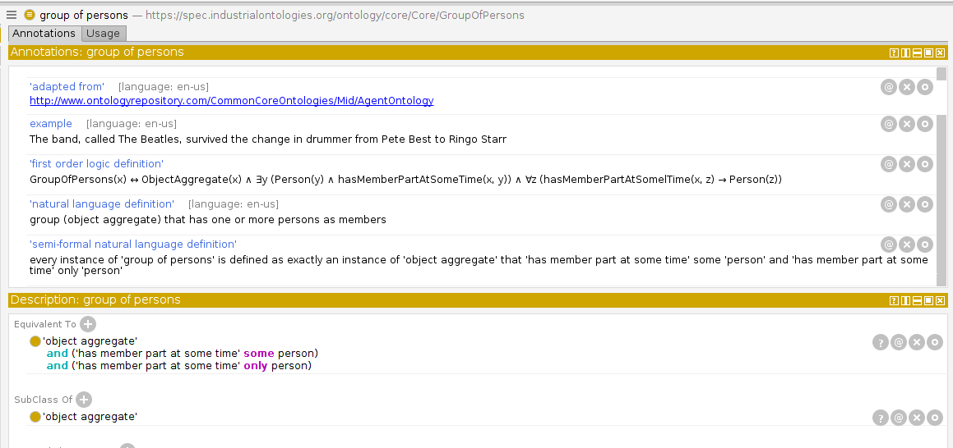
Moving constructs to the IOF Core – deprecation example
Deprecated construct in SCO
Construct as introduced in IOF Core
Moved all axioms and annotations
Marked as deprecated
Added “see also” (not shown)
Changed IRI
Made improvements (when useful)

Slide 21
Topics that will be covered in the IOF WG meeting
Representation of material state and event
Representing process models with the IOF Framework
Roadmapping the future development of IOF Core

Slide 22
Conclusions

