Slide 1
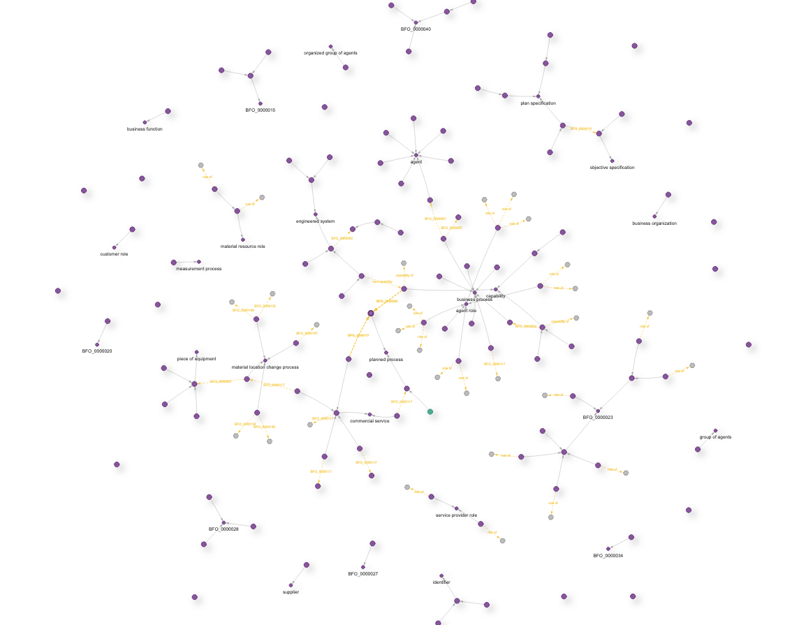
IOF Supply Chain WG Update
Farhad Ameri
School of Manufacturing Systems and Networks, Arizona State University
Open Industrial Digital Ecosystem Summit, February 2024
Tempe, AZ

Slide 2

Challenge Area: Data Integrity and Interoperability
Challenge: A global supply chain involves multiple partners, each using different systems and data formats, leading to challenges in integrating and exchanging information seamlessly.
Ontology Solution: Ontologies provide a common semantic framework, facilitating data integration and ensuring interoperability among different system
Manufacturer
Logistics partner
Retailer
ERP
TMS
POS
Notes:
Data Integration and Interoperability:
Challenge: Disparate data sources and incompatible systems lead to difficulties in integrating and exchanging information.
Ontology Solution: Ontologies provide a common semantic framework, facilitating data integration and ensuring interoperability among different system
A global supply chain involves multiple partners, each using different systems and data formats, leading to challenges in integrating and exchanging information seamlessly.

Slide 3
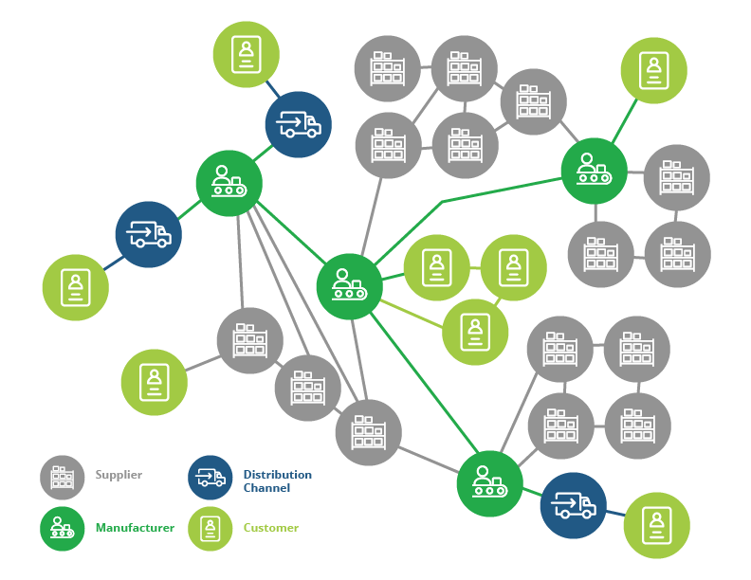
Challenge Area: Visibility and Traceability
Challenge: Lack of real-time visibility into the supply chain hampers effective tracking and traceability.
Ontology Solution: Ontologies enable the representation of events in the supply chain, improving visibility and supporting traceability of products and processes.
?
?
?
?
?
?
?
?
?
?
?
?
?
?
Notes:
Challenge: Lack of real-time visibility into the supply chain hampers effective tracking and traceability.
Ontology Solution: Ontologies enable the representation of relationships and events in the supply chain, improving visibility and supporting traceability of products and processes

Slide 4

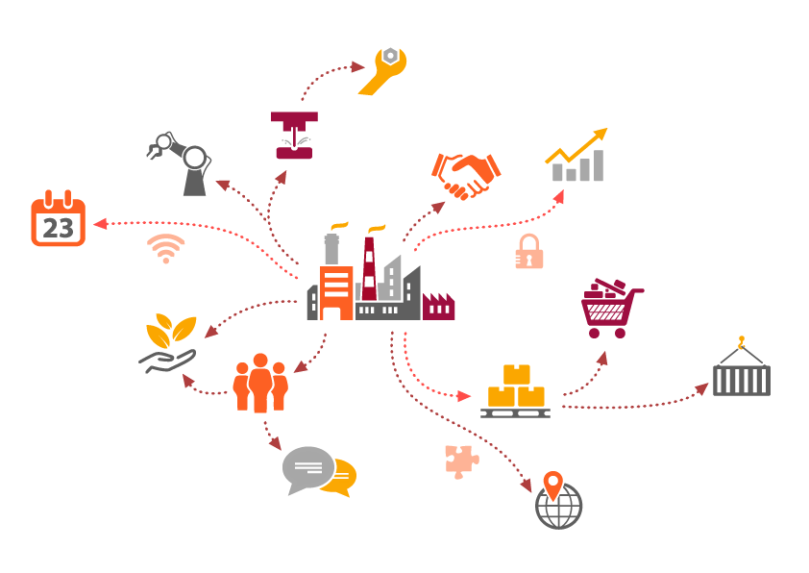
Challenge Area: Manufacturer Capability Representation
Challenge: Traditional method for representation of supplier capabilities often lack the granularity and interoperability needed for effective sourcing and supplier discovery.
Ontology Solution: Ontologies enable formal, granular and standardized representation manufacturer’s capabilities.
I can interpret the capability model of this manufacturer

Slide 5
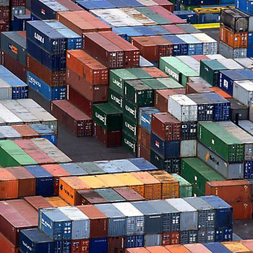
Benefits of Supply Chain Integration information integration
Enhanced transparency and visibility
Real-time intelligence
Enhanced collaboration, communication and data exchange
Flexibility, agility, and resilience.

Slide 6
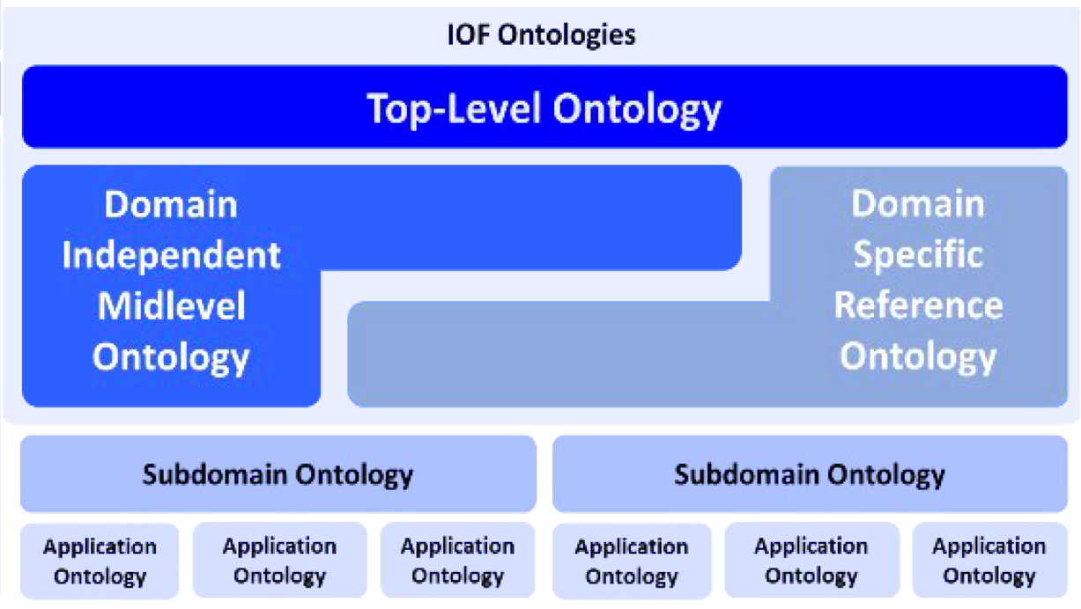
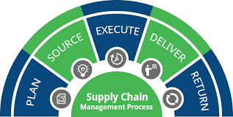
IOF Supply Chain WG
Objective:
  Identify the requirements of reference ontologies in the supply chain domain.
  Develop Supply Chain Reference Ontology and other lower-level ontologies in SC domain.
  Validate them through use cases.
Scope:

Slide 7
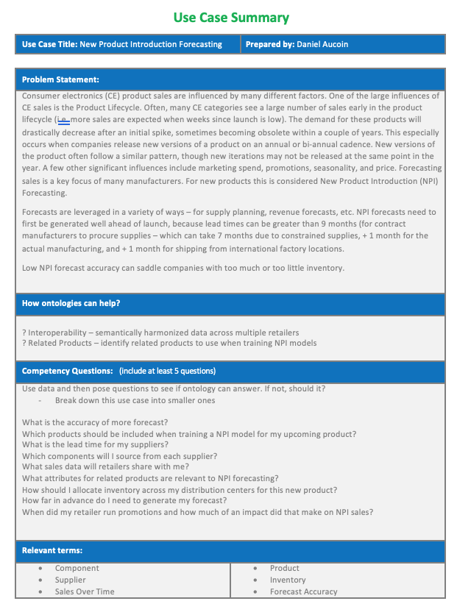
Use Case Driven Approach
Supplier Discovery
New product Introduction Forecasting
Forecast Collaboration
SC Traceability
Smart Container
SC Logistics

Slide 8
Supplier Discovery Use Case
How ontologies Help:
Standardization/interoperability
Semantic Search
Problem Statement:
Competency Questions (CQ):
Which suppliers can machine aerospace parts with complex geometries ?
What is the precision machining capability of this supplier?
What is the maximum production capacity of this supply chain for product x?
What is the minimum wall thickness that can be machined in this factory?
What is the largest diameter that can be turned in the factories owned by this company?
What is the capability of this factory with respect to surface roughness?

Slide 9

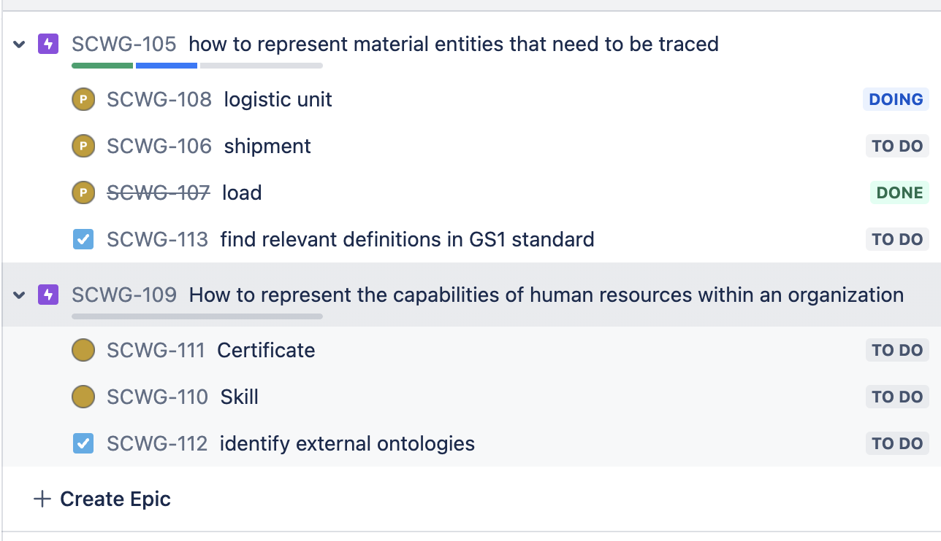
Development Procedure
External Sources
GS1, SCORE, APICS, CSCMP, …
Use Case
Issues (Epic, tasks, bugs, …)
Linguistic & Ontological Analysis
Annotation
Test and Validation

Slide 10
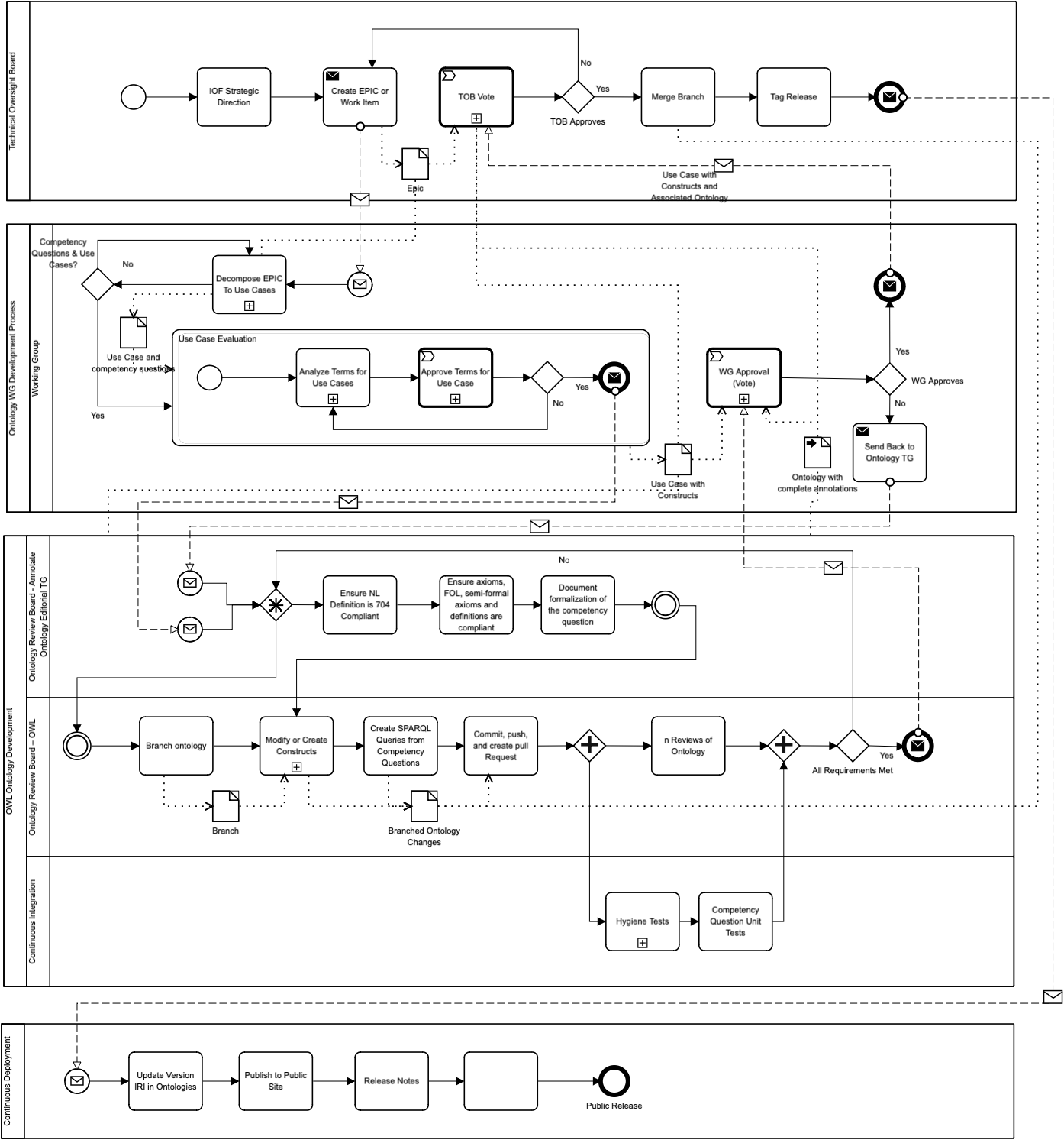
Development Process (BPMN): Proposed process
Identify work item (Epic) - TOB
Ontology development - WG
  Decompose epic to use cases
  Identify competency questions
  Ontological and linguistic analysis
  OWL ontology development
Ontology review and Release – Review Board
  Ensure NL definitions are ISO 704 compliant
  check FOL, semi-formal, OWL axioms
  Run SPARQL queries
  Run hygiene test
  Approval, voting and release

Slide 11
SC Ontology Import Structure
SupplyChain.OWL
IRI: https://spec.industrialontologies.org/ontology/supplychain/SupplyChain
Import
IOF Core
IRI: https://spec.industrialontologies.org/ontology/core/Core
Import
Import
BFO
IOF AV

Slide 12
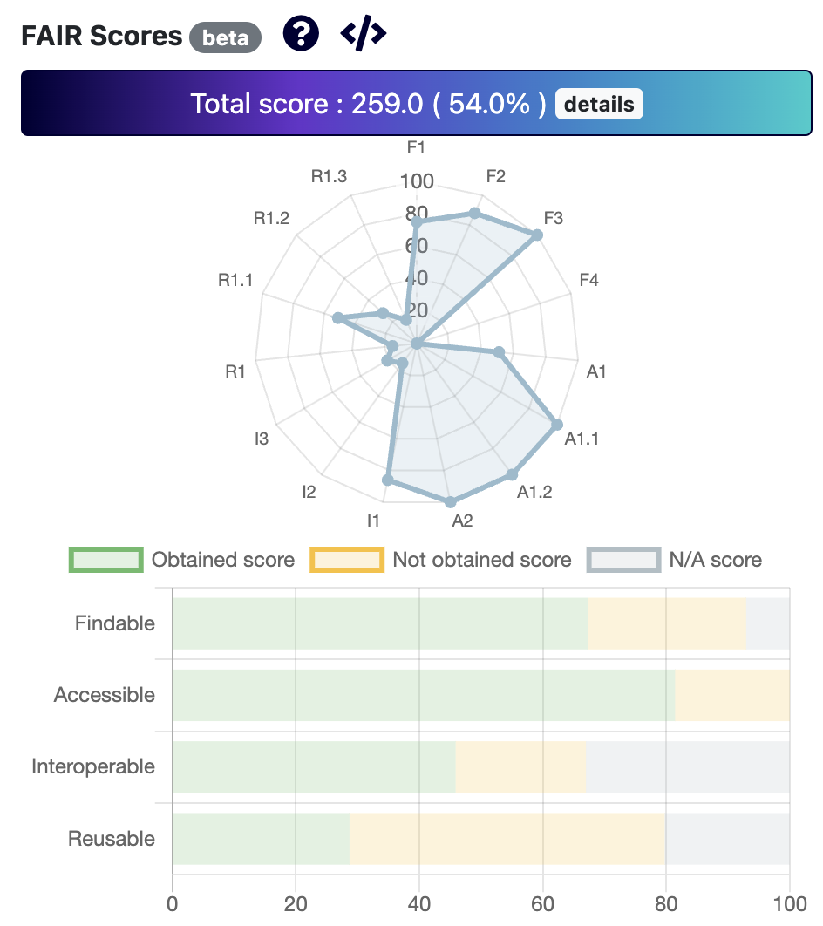
Supply Chain Reference Ontology: First Release
Released in January 2023
Motivated by supplier discovery and grain traceability use cases
Available on:
  IOF GitHub:
    https://github.com/iofoundry/ontology/tree/master/supplychain
  Industry Portal:
    https://industryportal.enit.fr/ontologies/IOF-SCRO

Slide 13
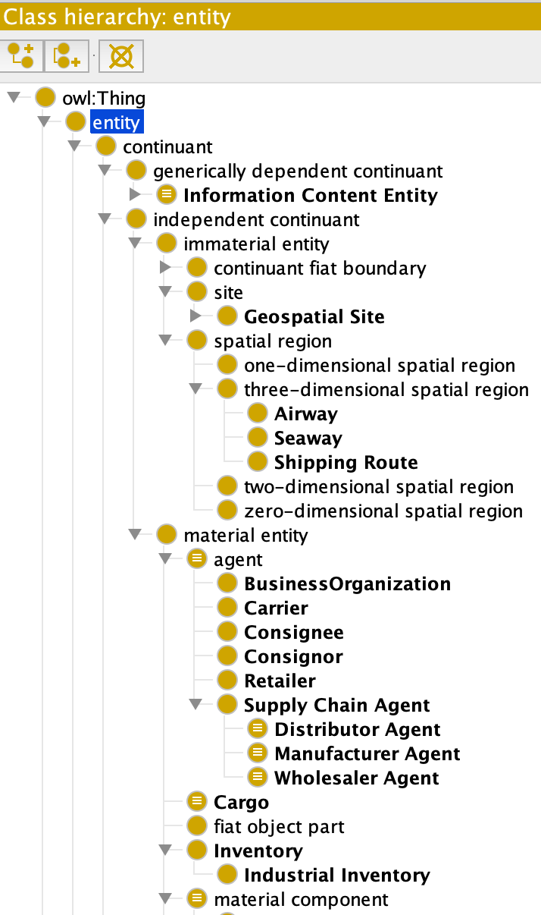
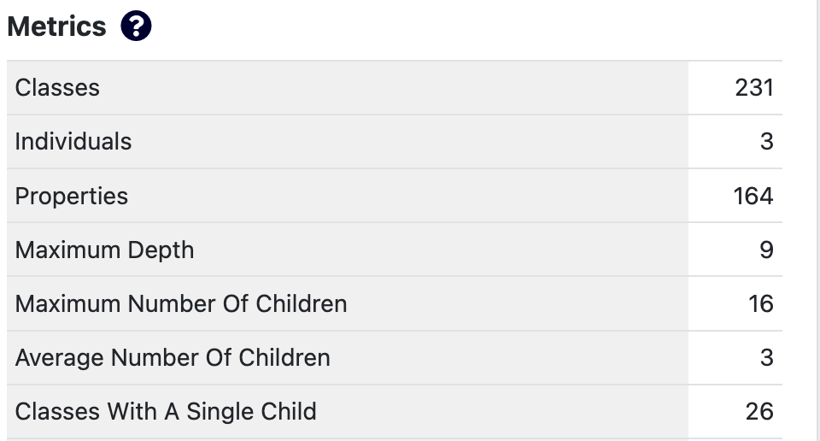
Supply Chain Reference Ontology: First Release
84 continuants
26 occurrents
11 relationships
Some highlights :
  Locations, facilities, agent and roles, supply chain processes and services, transportation routes, loads, shipments identifiers and classifiers

Slide 14
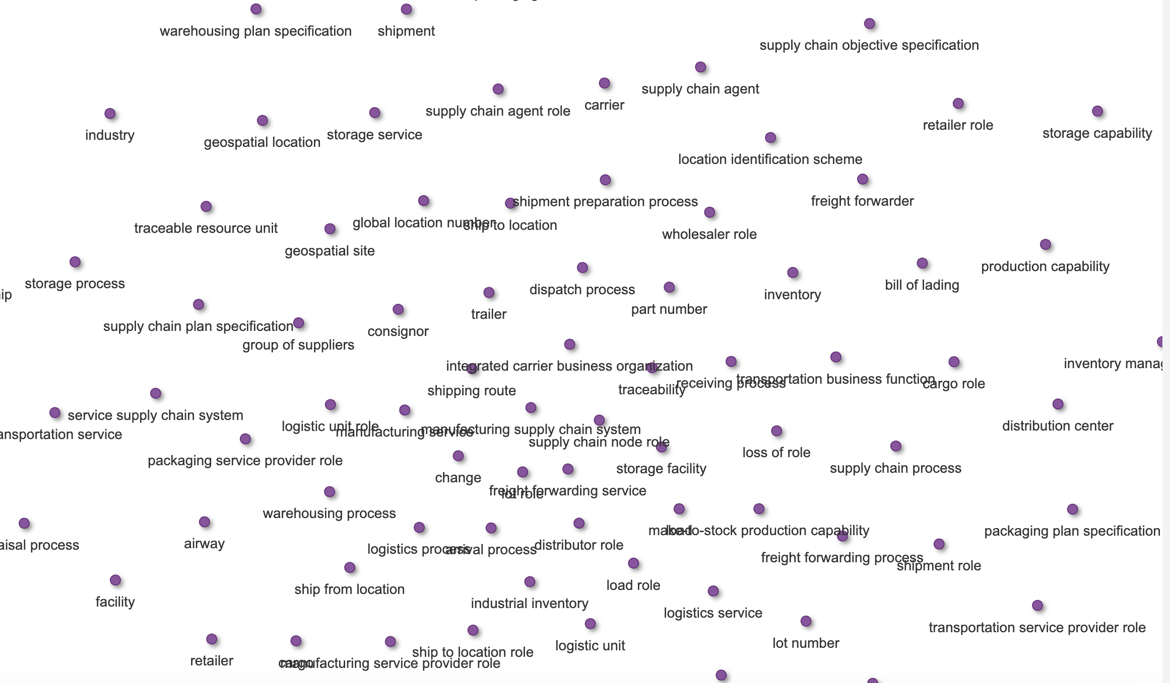
Example Class Structures

Slide 15
Roles

Slide 16
Business Processes

Slide 17
Immaterial Entities

Slide 18
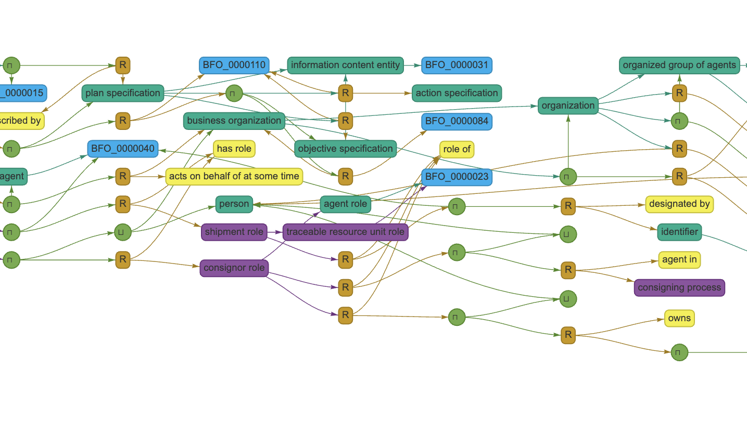
Example Class Diagrams/Axioms

Slide 19
Supplier and Supplier Role
Axiom 1: Supplier(x) ↔ (BusinessOrganization(x) ∨ Person(x)) ∧ ∃r (SupplierRole (r) ∧ hasRole (x,r))
Axiom 2: SupplierRole(x) → Role(x) ∧ ∃y,∃p ((BusinessOrganization(y) ∨ Person(y) ∨ EngineeredSystem(y)) ∧ ((SupplyingBusinessProcess(p) ∨ OfferingForSaleBusinessProcess(p)) ∧ participatesInAtSomeTime(y,p) ∧ roleOf(x, y))

Slide 20
Supply Chain System
engineered system composed of agents, facilities, machines, and information systems that is designed to deliver products and services to end customers through an engineered flow of information, material, and cash
SupplyChainSystem(x) ↔EngineeredSystem(x) ∧ ∃s((CommercialService ∨ ProductProductionProcess) ∧ (participatesInAtSomeTime (x,s)) ∧ ∃g(GroupOfSuppliers(g) ∧ hasContinuantPartAtAllTime (x,g)
∃p(SupplyChainPlanSpecification(p) ∧ prescribes(p,x))

Slide 21
Supply Relationship
Supply Relationship (Alcola selling aluminum ingots to Nemak)

Slide 22
Supply Relationship
relationship that exists between two agents when one agent supplies a product or service to another agent and that is prescribed by an agreement or contract

Slide 23
Locations
Some locations can be modeled through roles
Location Role x is a 'role' that is the 'role of' some Geospatial Site that is 'location of at some time' some 'material entity' or 'is site of' some 'process'

Slide 24
Supply Chain Node Role
location role held by a geospatial site when it is the site some supply chain process
SupplyChainNodeRolel(x) ↔ LocatinRole(x) ∧ ∃g,∃p (GeospatialSite(g) ∧ SupplyChainProcess(p) ∧ isSiteOf(g,p) roleOf(x,g))

Slide 25
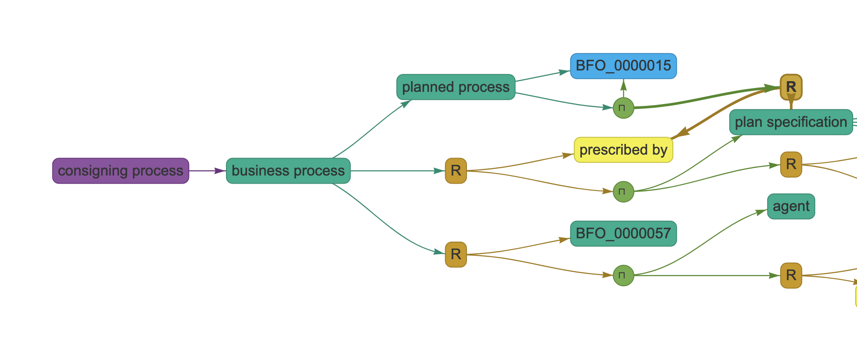

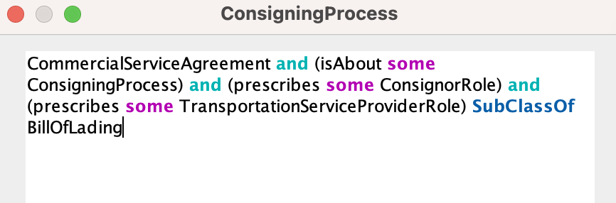
Consigning Process
Sufficient Condition

Slide 26
Identifiers
Iof-core: Identifier: information content entity that is used to uniquely identify an entity within a particular context
Examples:
  Serial number
  Tracking number
  Lot number
  Location identifier
  Part number

Slide 27
Tracking Number

Slide 28
Classifiers
Classifier: standardized classification or delineation for something, per some scheme for such delineation, within a specified context
  Example:
    NAICS Code
    Global Trade Item Number
    UNSPSC (United Nations Standard Products and Services Code)

Slide 29
GTIN (Global Trade Item Number)

Slide 30
NAICS Code

Slide 31
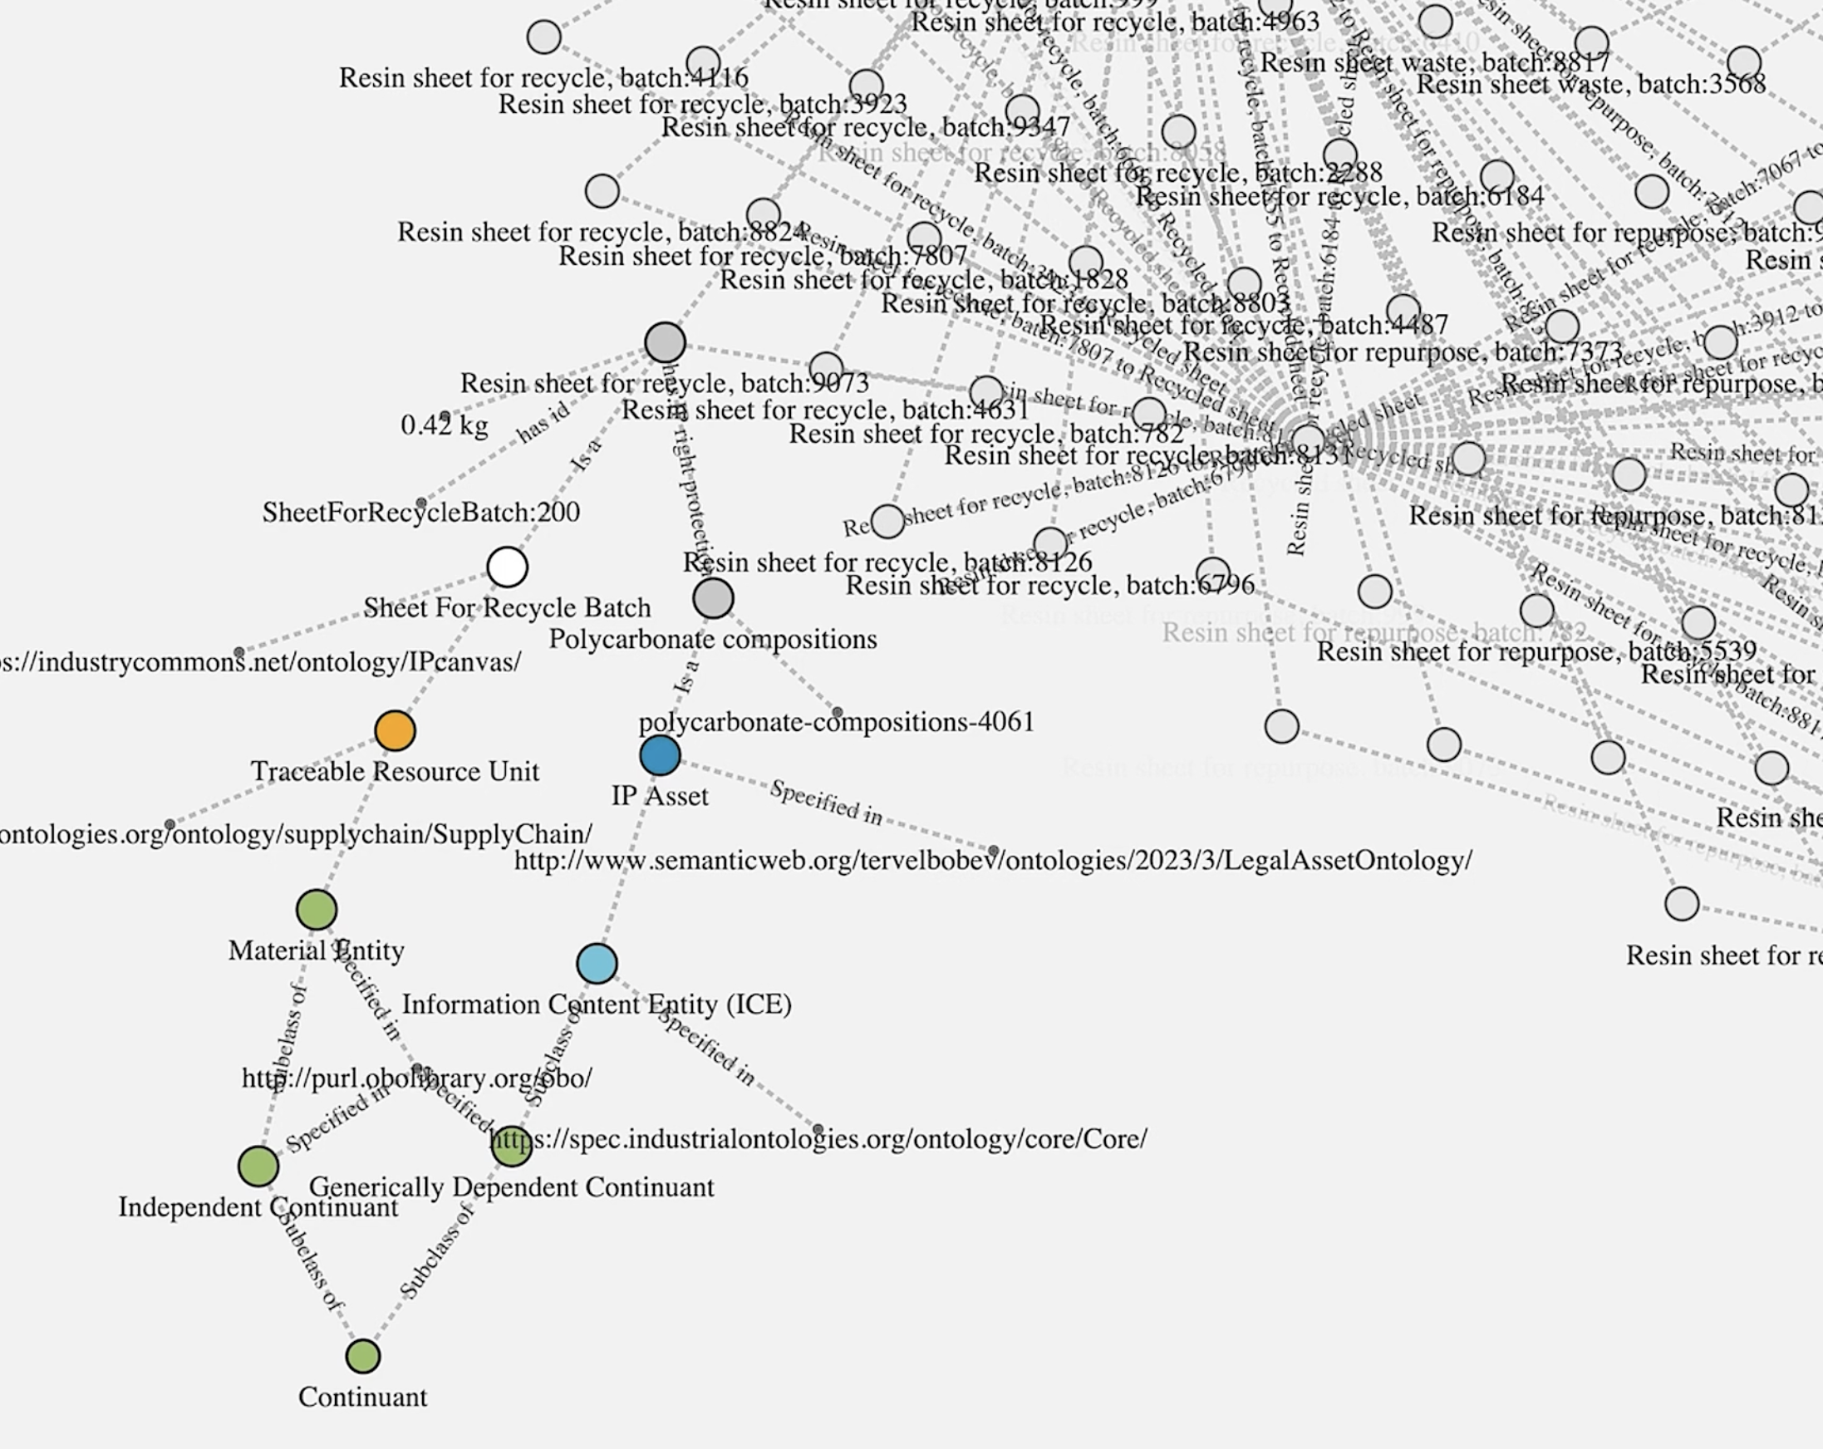
SC Ontology in use: RE4DY Project in Europe
Circularity management in polycarbonate sheet manufacturing

Slide 32

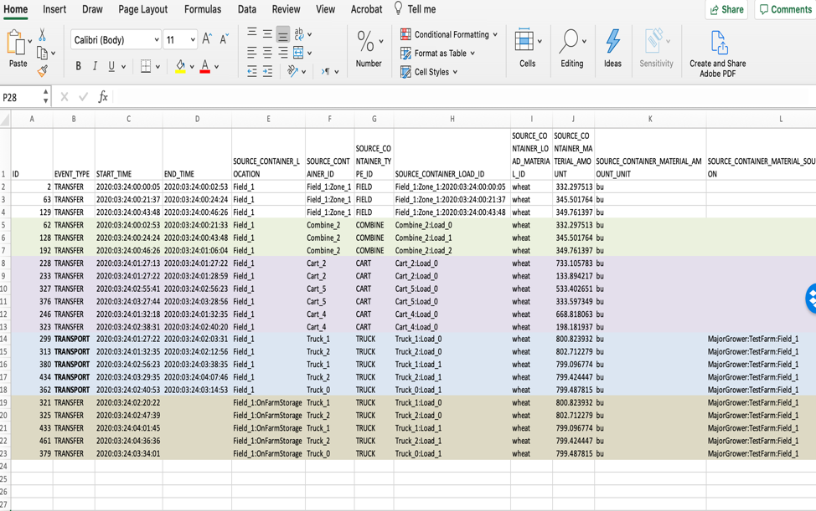
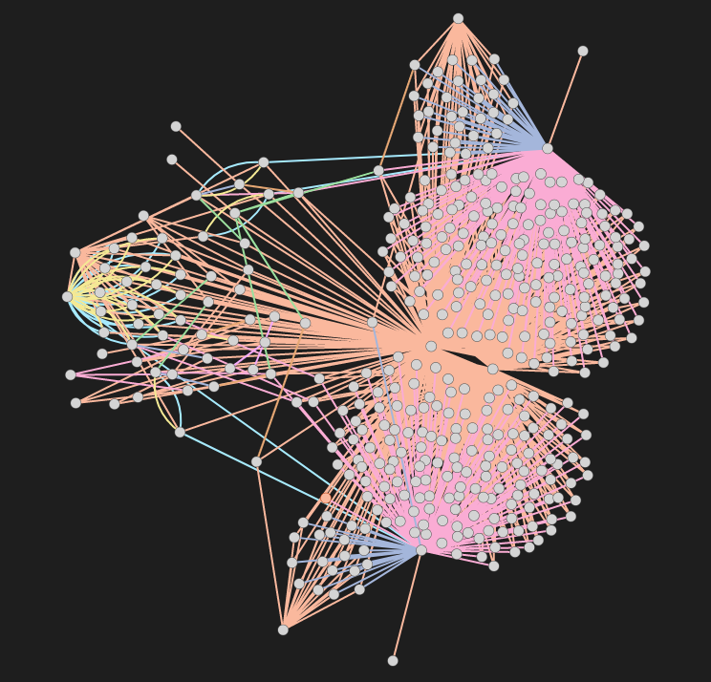
Grain Traceability Use Case: Harvest to on-farm storage

Slide 33
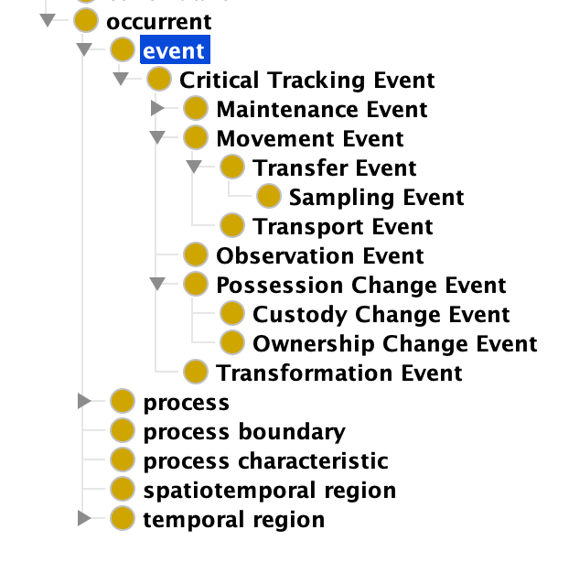

Critical Tracking Events (CTE)
CTE: Those events that must be recorded in order to allow for effective traceability of products in the supply chain

Slide 34
Ownership Change Event

Slide 35
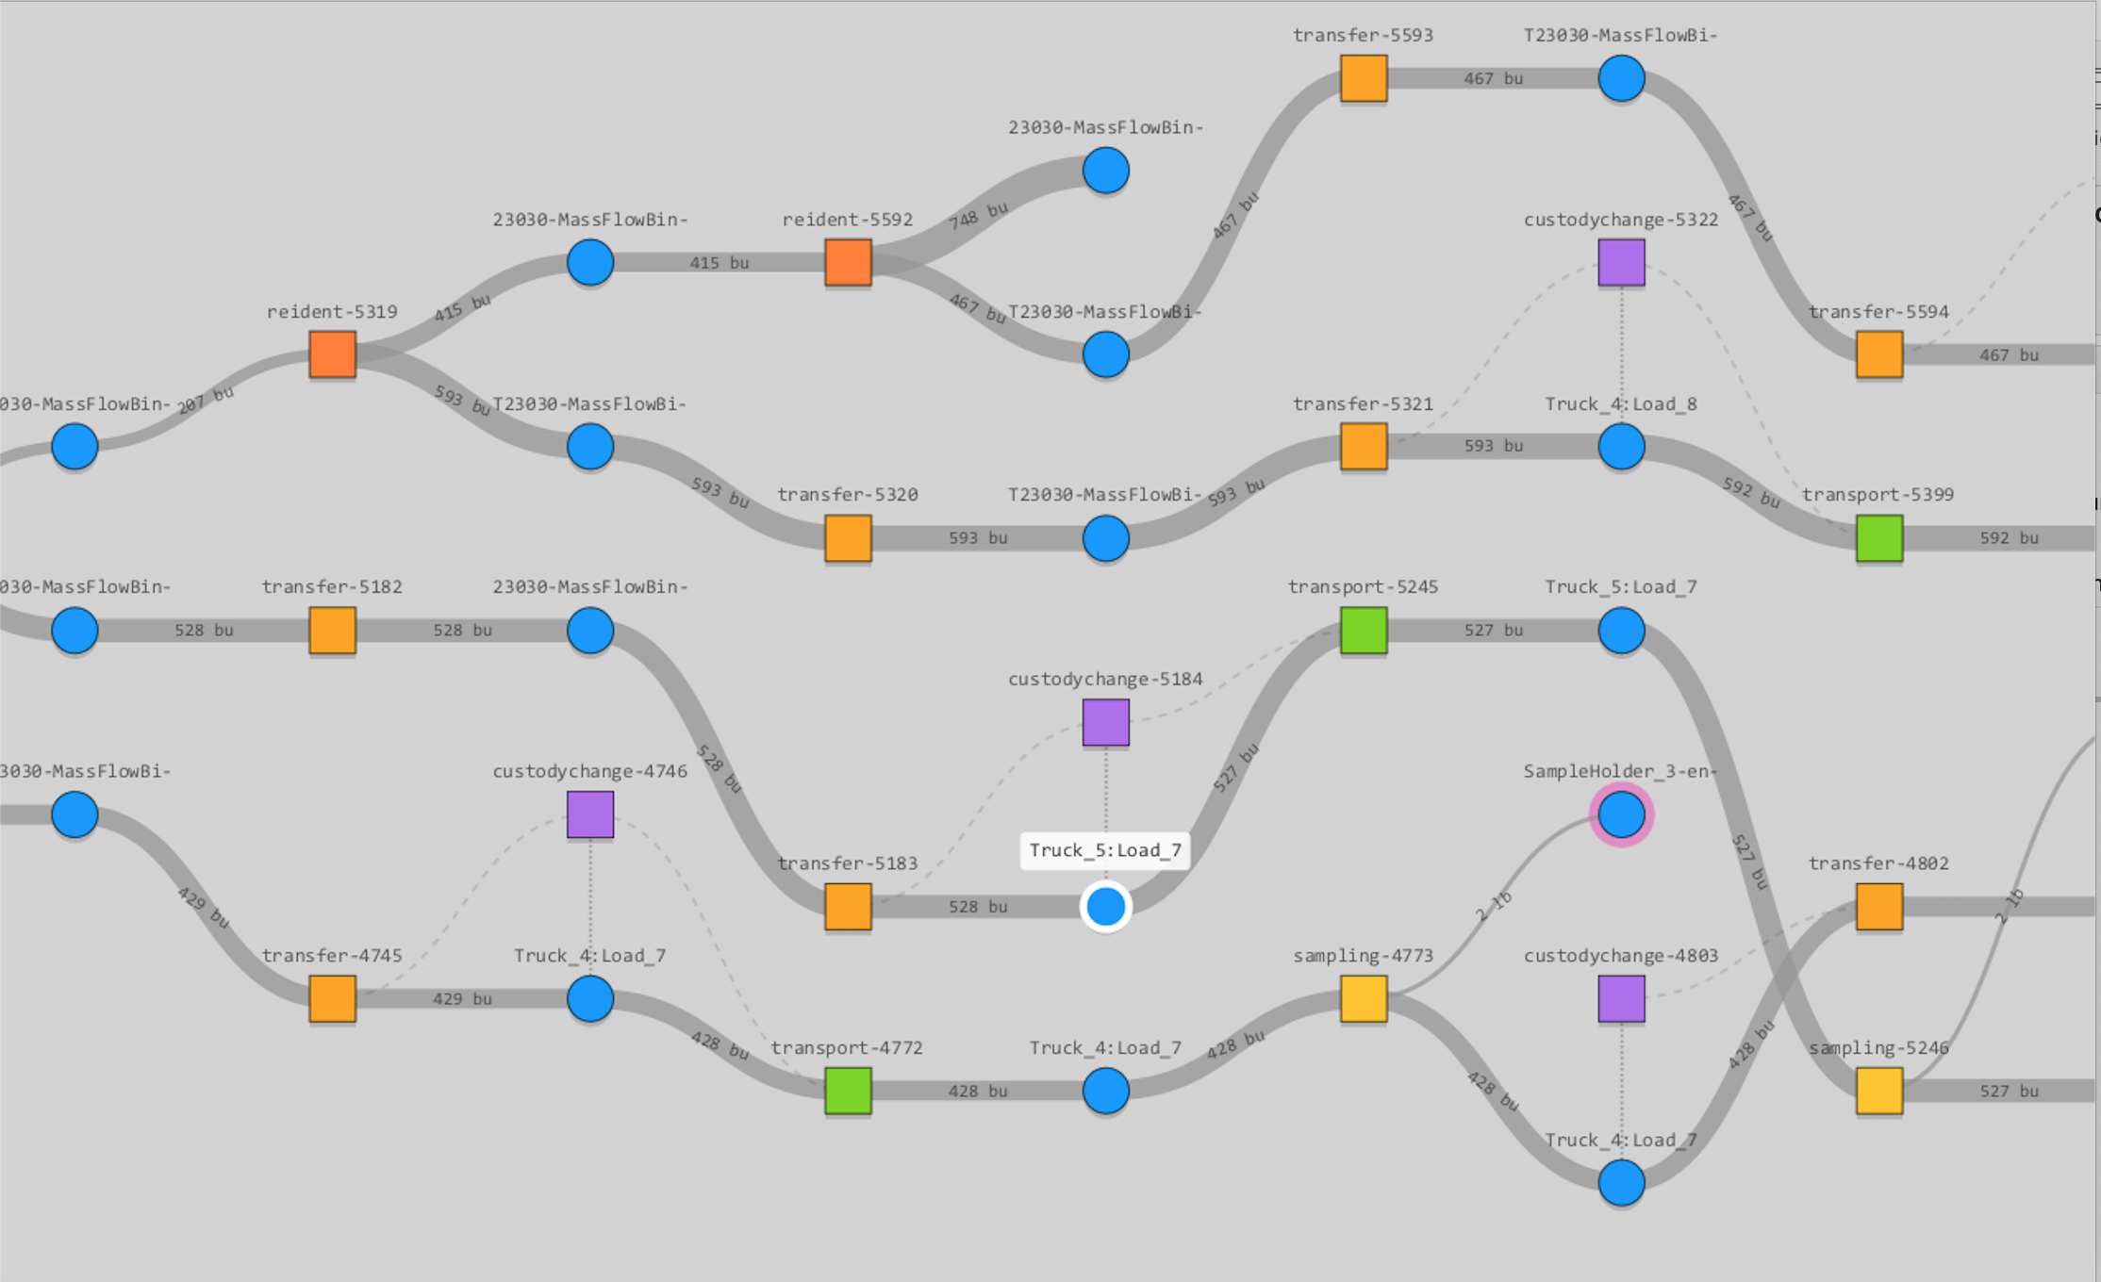
SC Ontology in use: Grain Traceability Project

Slide 36
Next Steps
Areas of focus:
  Manufacturers’ Capabilities
  Skills and Occupations (reuse OccO)
  Shipment States
    In-transit, delayed, delivered, diverted
  Inventory status
  Demonstrate rule-based reasoning
What we need:
  Supply chain and logistics use cases supported by data
  Participation of domain experts in WG meetings
  We need more WG members!

Slide 37

Publications
Farhad Ameri, Evan Wallace, Reid Yoder, Frank Riddick (2022) Enabling Traceability in Agri-Food Supply Chains Using an Ontological Approach, ASME Journal of Computing and Information Systems in Engineering (JCISE), October 2022; 22(5): 051002. https://doi.org/10.1115/1.4054092
Ameri, F., Sormaz, D., Psarommatis, F., & Kiritsis, D. (2021). Industrial ontologies for interoperability in agile and resilient manufacturing. International Journal of Production Research, 1-22. https://doi.org/10.1080/00207543.2021.1987553
Farhad Ameri, Evan Wallace, Boonserm Kulvatanyou, and Chris Will, Towards a Reference Ontology for Supply Chain Management, Proceedings of International Conference on Interoperability for Enterprise Systems and Applications (I-ESA), IOF Workshop, November 2020, France, Tarbes.
Farhad Ameri, Evan Wallace, Reid Yoder, Enabling Traceability in Agri-Food Supply Chains Using an Ontological Approach, ASME International Design Engineering Technical Conferences and Computers and Information in Engineering Conference, ASME IDETC2020-19995, August 2020, St. Louis, MO.
Farhad Ameri and Boonserm Kulvatanyou, Modeling a Supply Chain Ontology Based on a Top-Level Ontology, International Design Engineering Technical Conferences and Computers and Information in Engineering Conference, Volume 1B: 38th Computers and Information in Engineering Conference, ASME IDETC2019-98278, Anaheim, CA, August 2019.

Slide 38
Thank You
Farhad.Ameri@asu.edu

