Slide 1
Mapping activity models to IOF ontologies

Slide 2
Agenda
Motivation
A simple, example activity model
Using the explanatory power of an IOF ontology
Generating OWL and rendering in Protege
Example occurrences
Example inferences
Future work
Q&A

Slide 3
Motivation
An activity model is a standardized way to represent process plans
Activity models are heavily used in industry
The relationship of activity models to IOF ontologies has not yet been made explicit
This is an opportunity to demonstrate the explanatory power of IOF ontologies

Slide 4
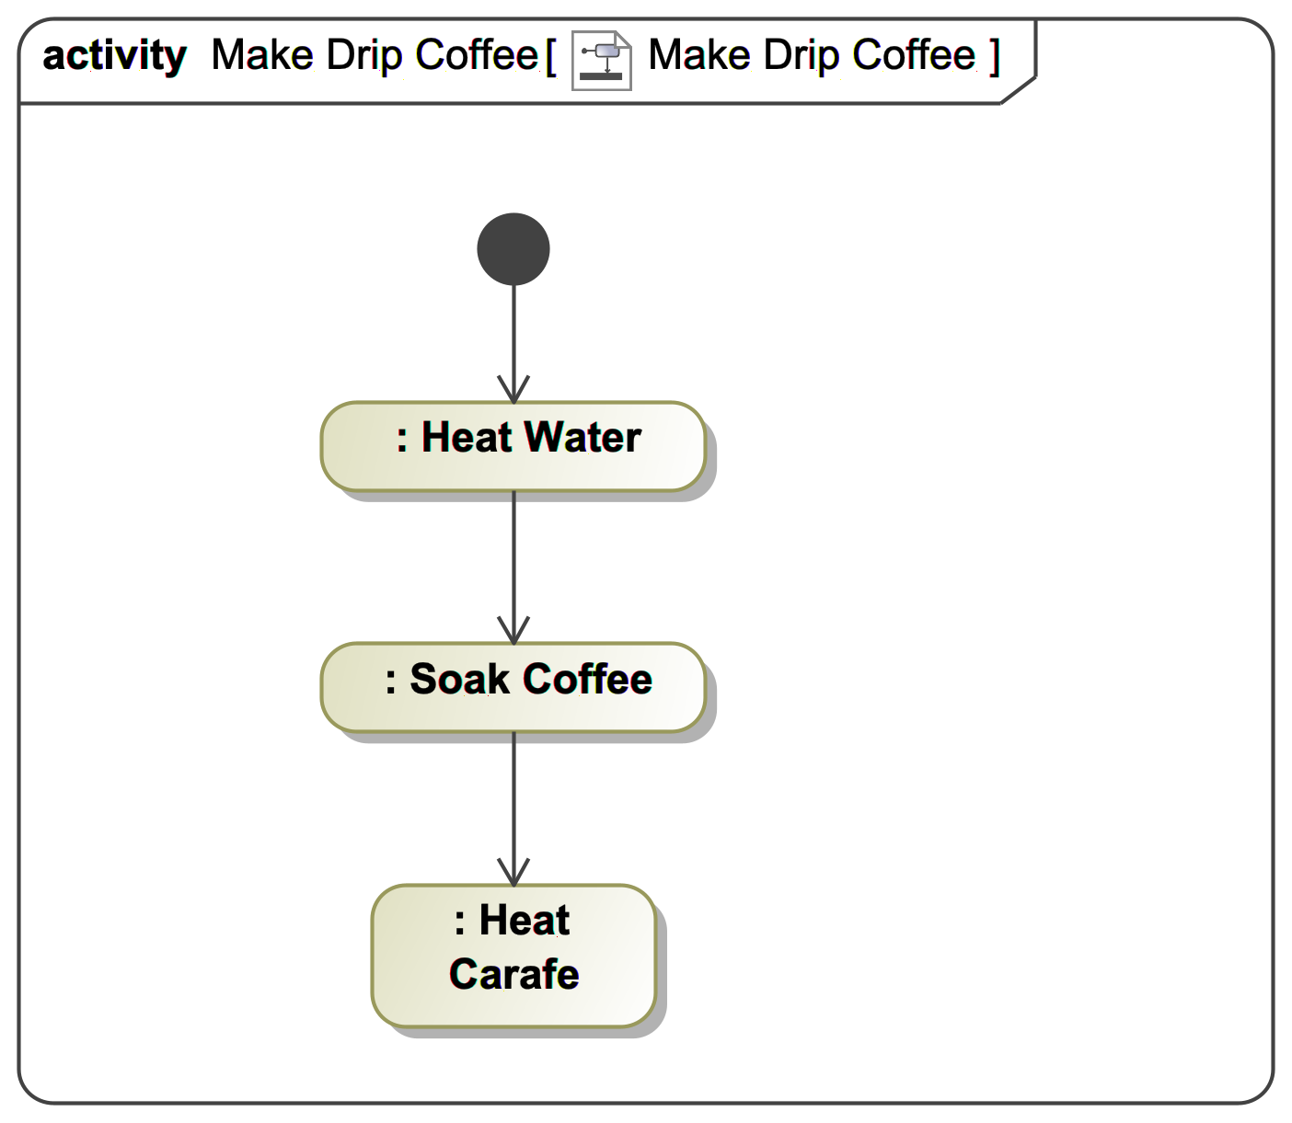
A simple, example activity diagram
Note:
Heating the carafe continues until power is removed
To keep things simple, no interaction with a user is shown

Slide 5
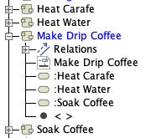
The underlying UML model
Note:
A diagram represents one model
A model can be represented by many diagrams
A different representation of the same model appears on the next slide

Slide 6
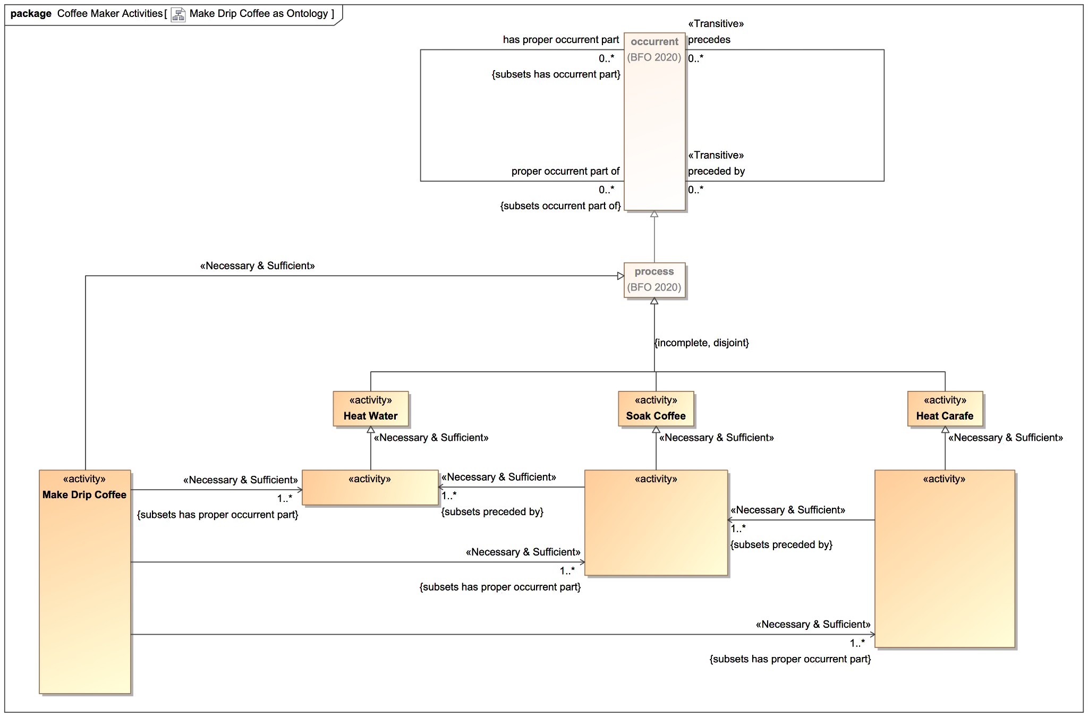
Using the explanatory power of an IOF ontology
Note:
This notation extends standard UML to cover OWL
It is implemented in the Cameo Concept Modeler

Slide 7
Example instances that demonstrate reasoning

Slide 8
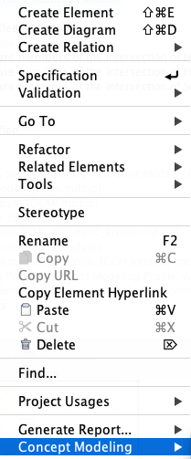
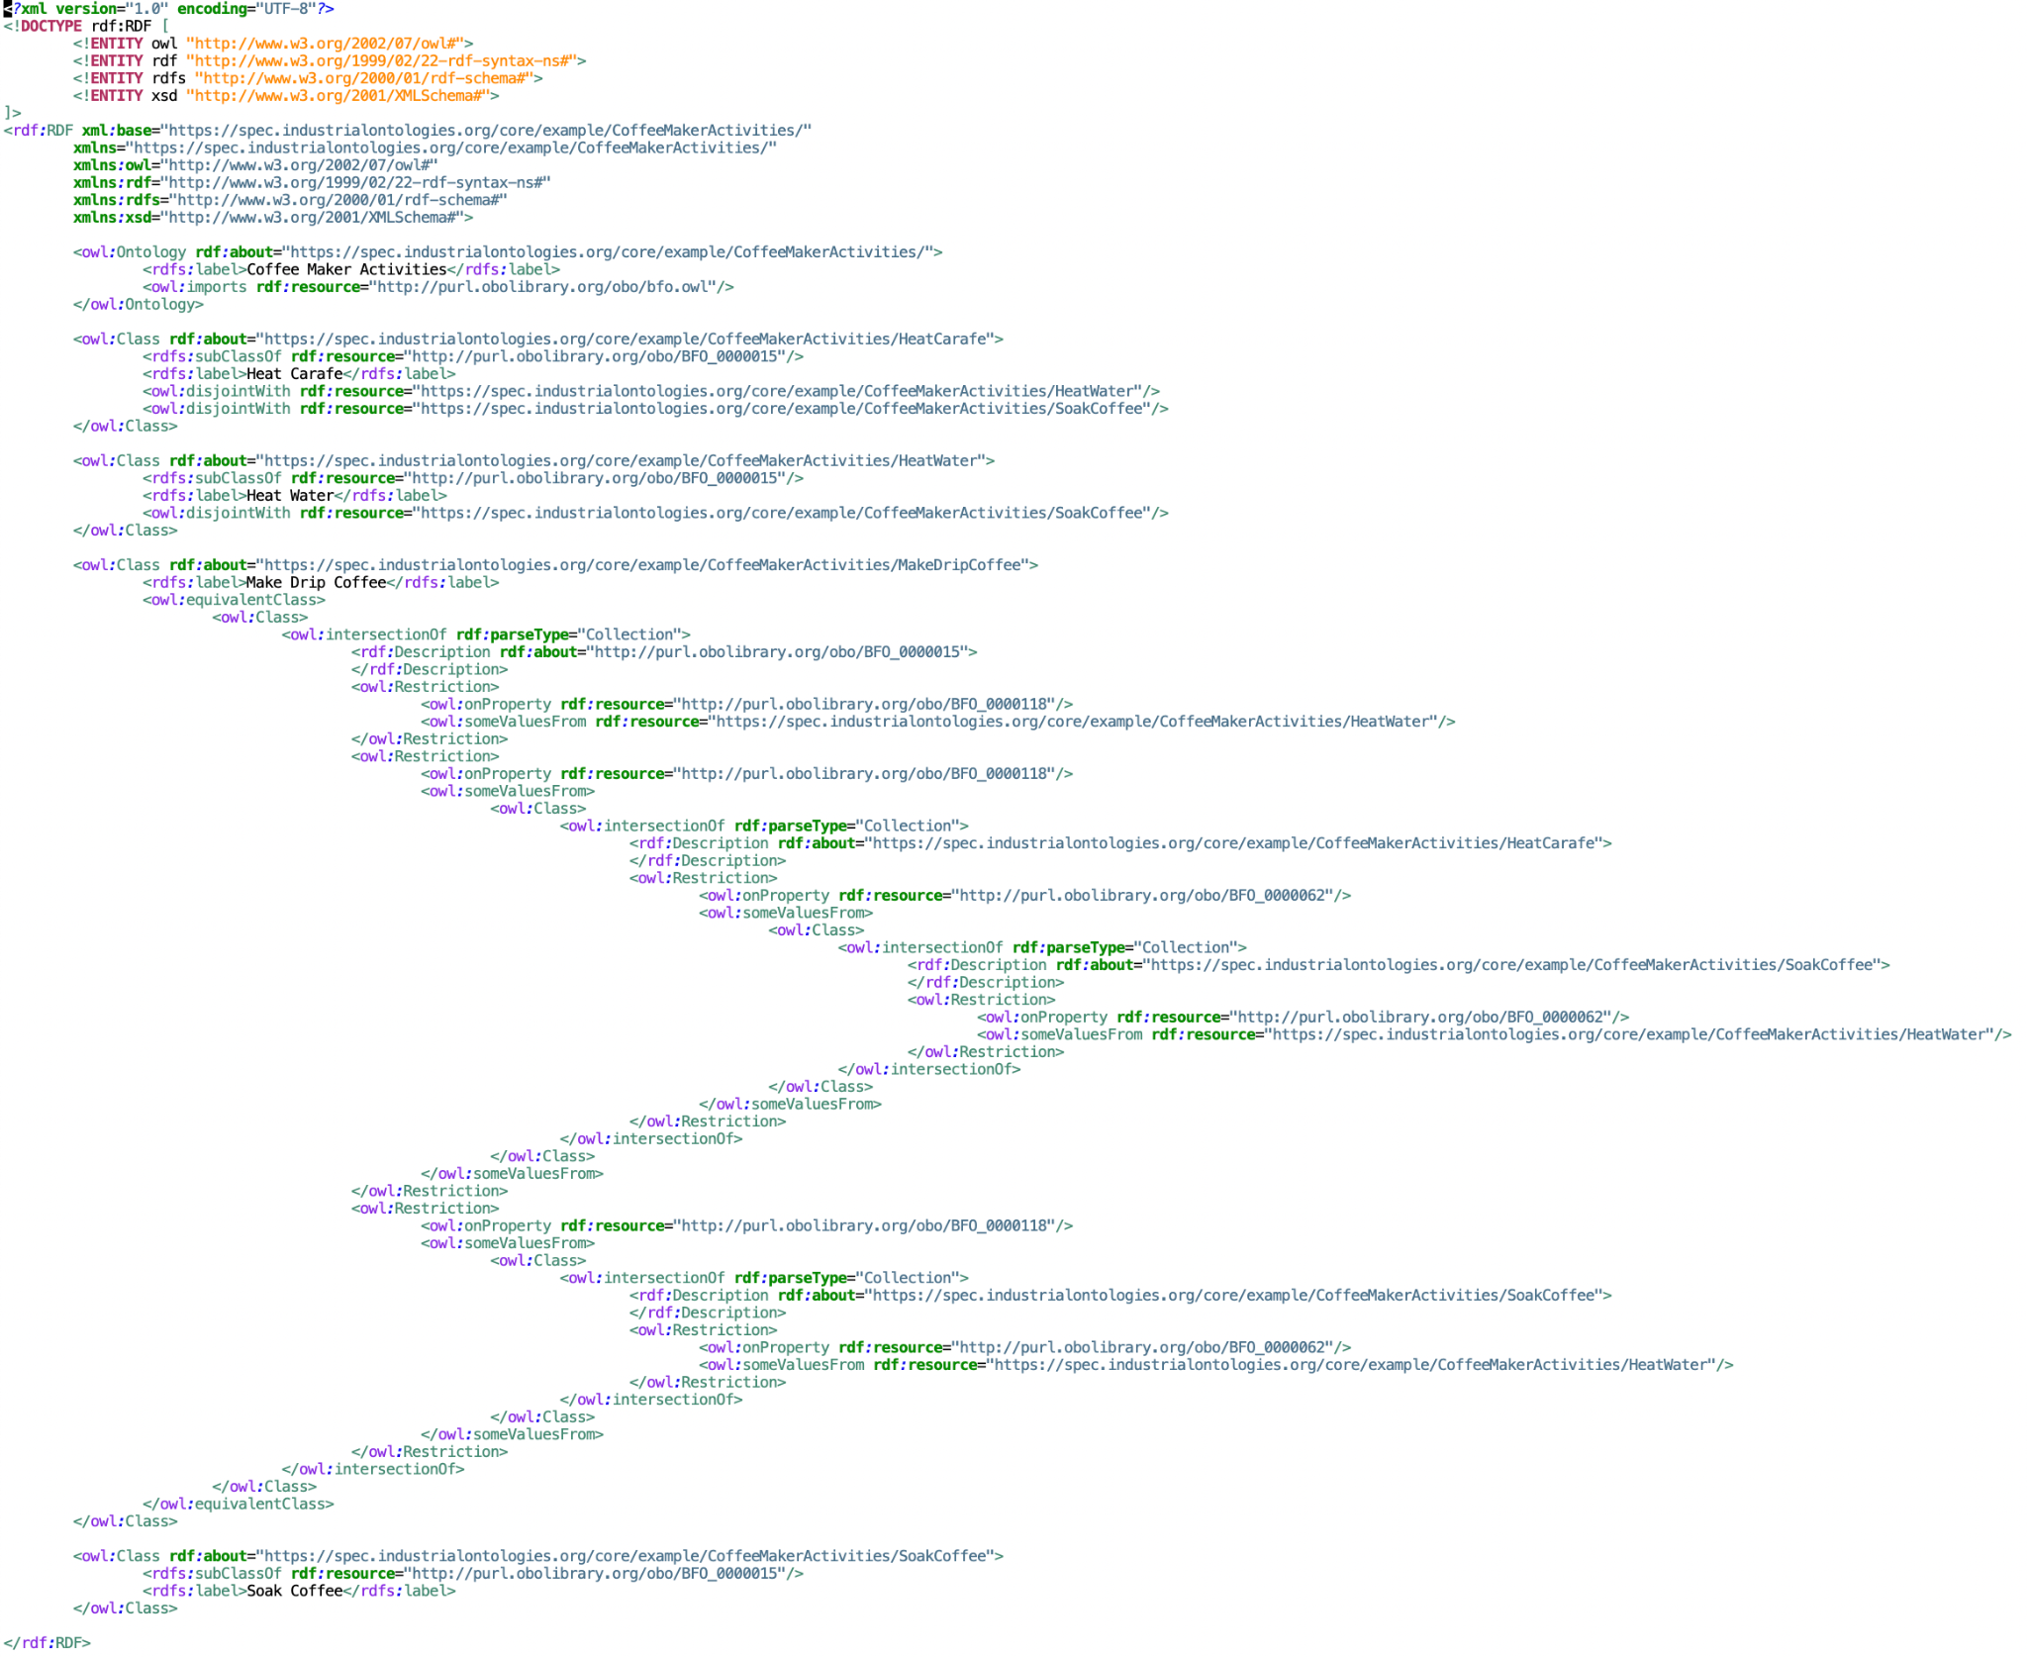
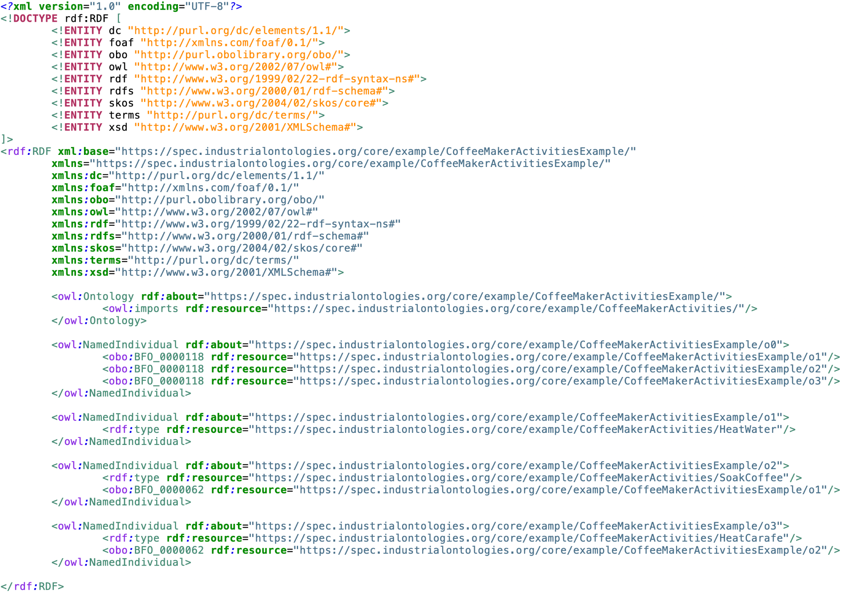
Generating OWL

Slide 9
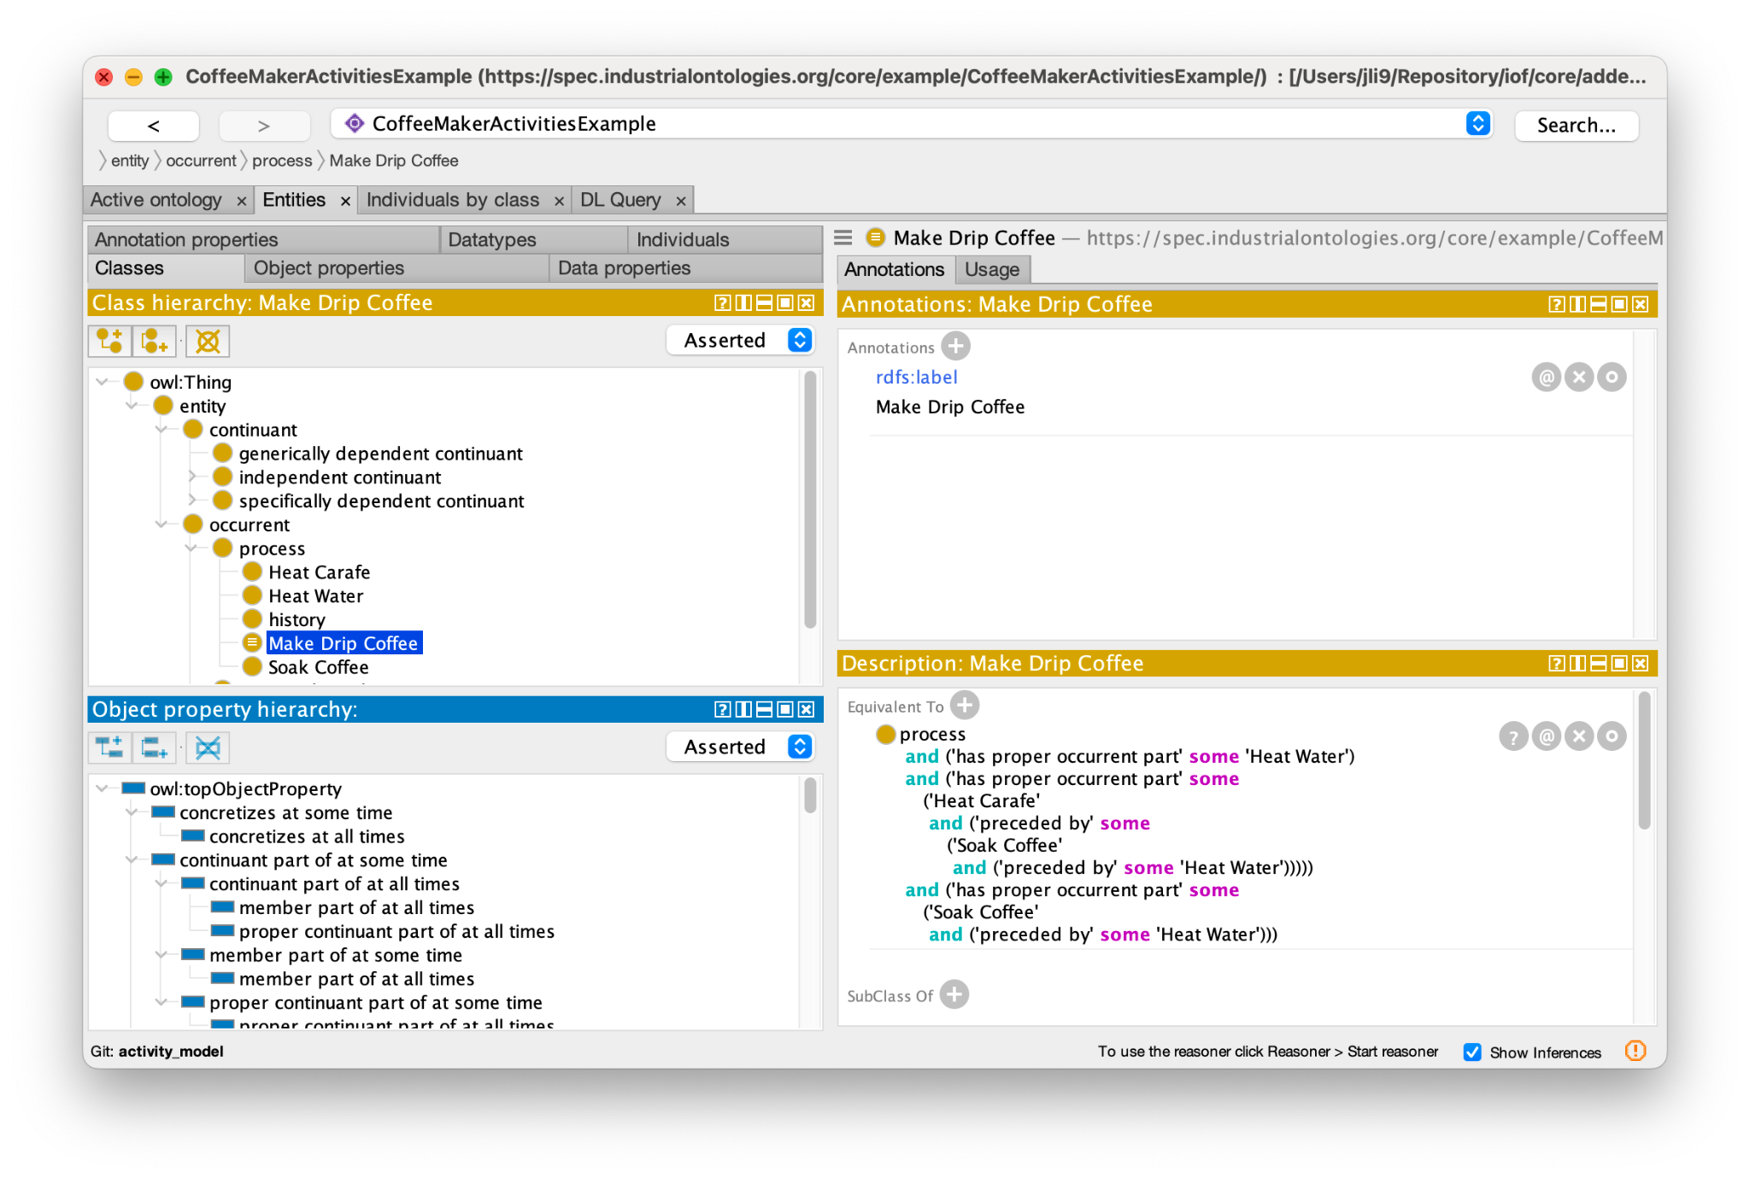
Classes rendered in Protege

Slide 10
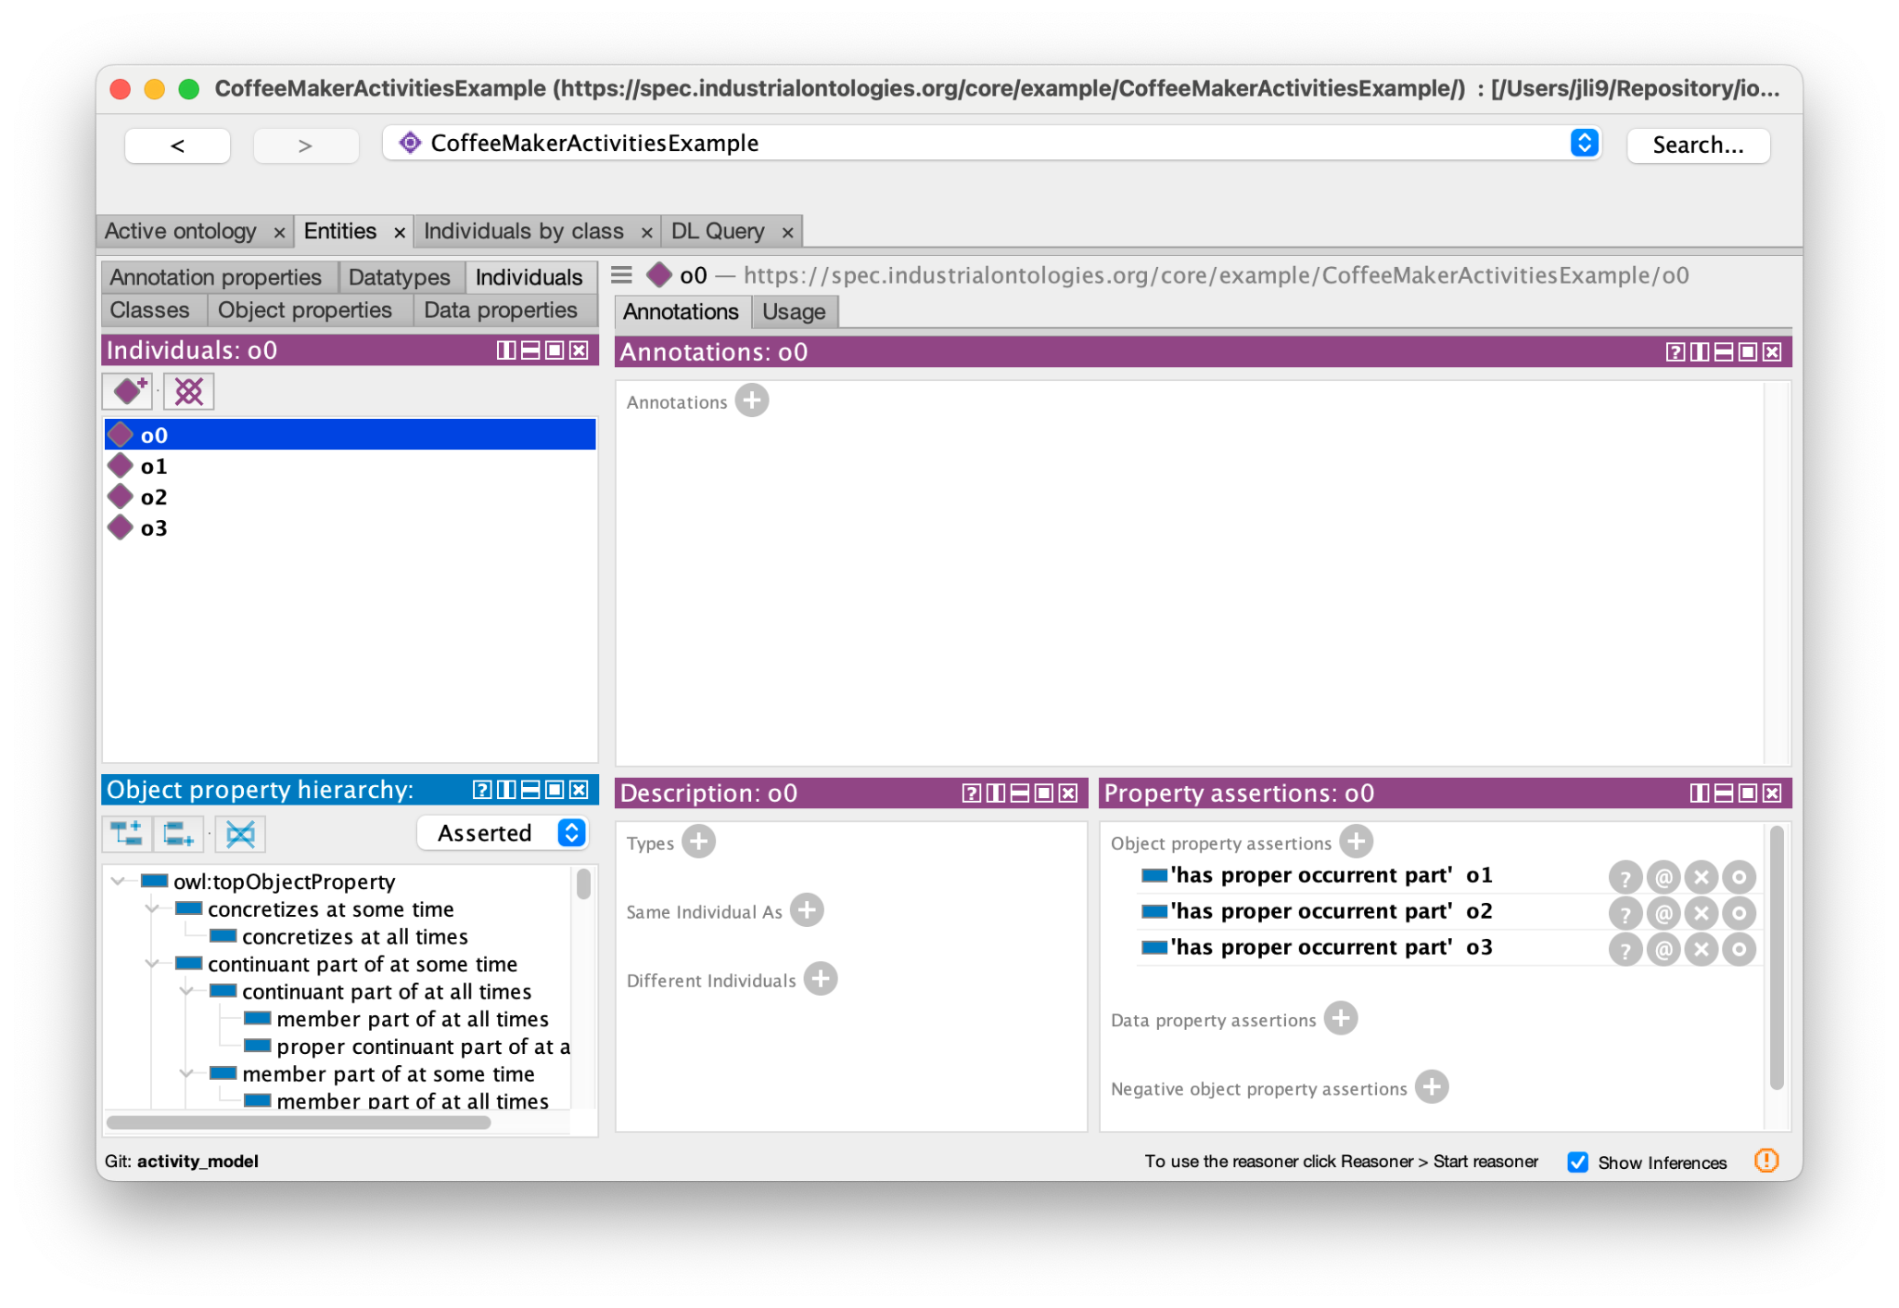
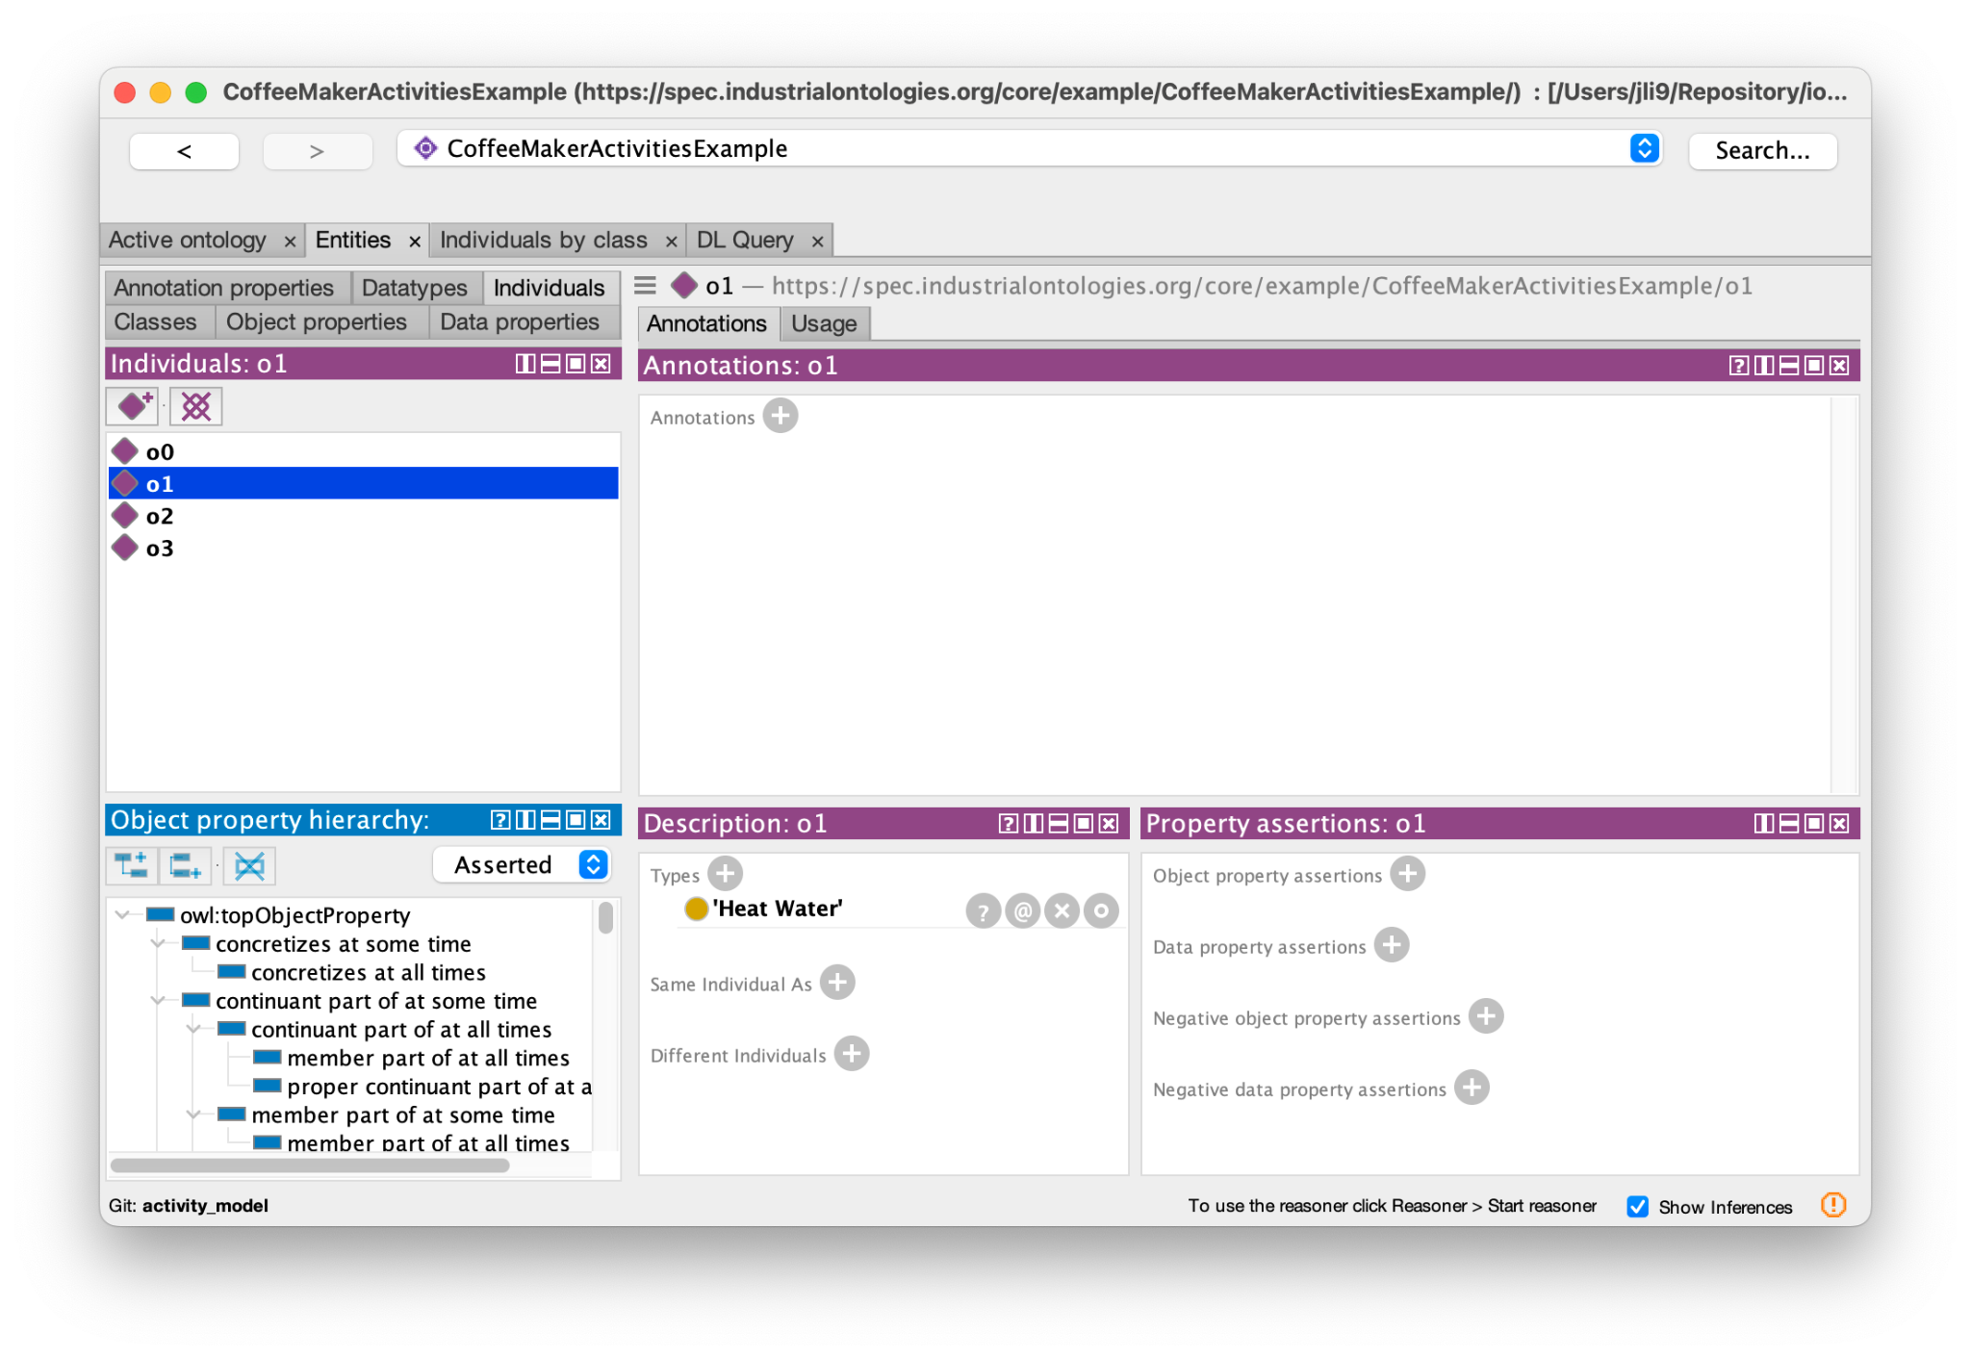
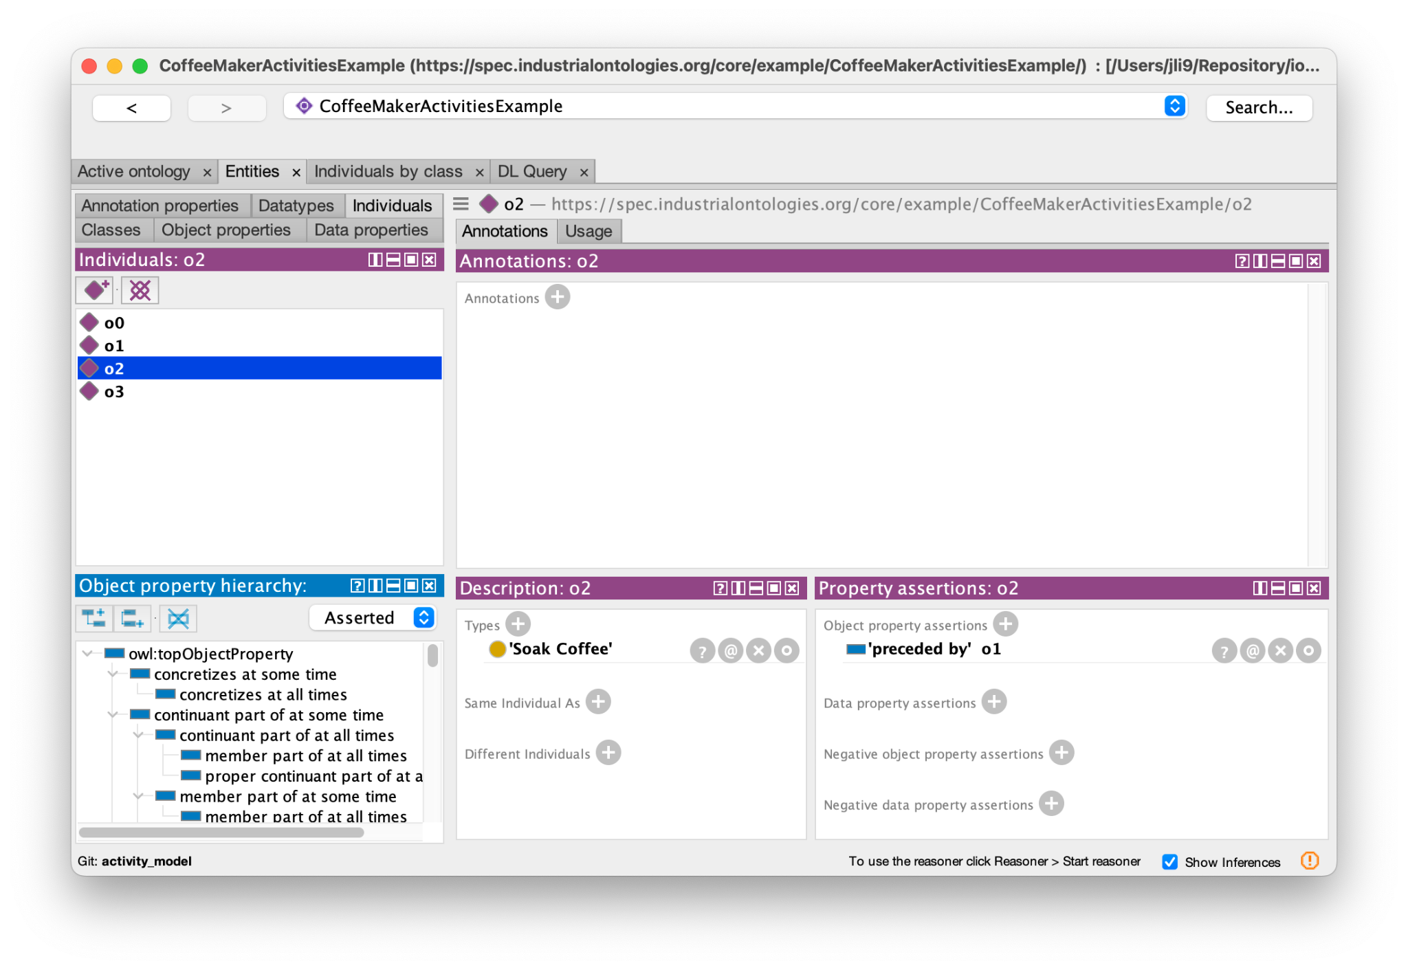
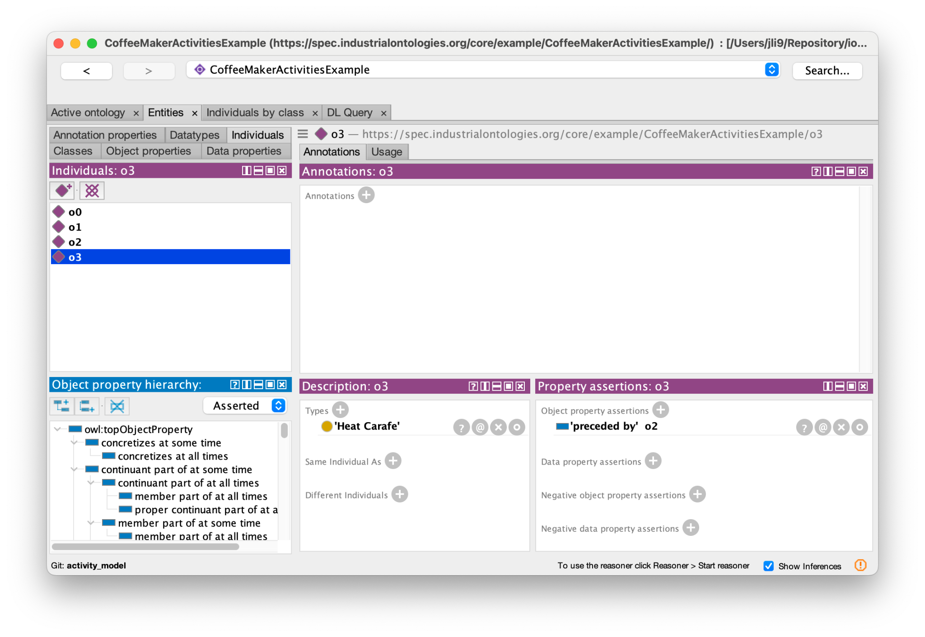
Instances rendered in Protege

Slide 11
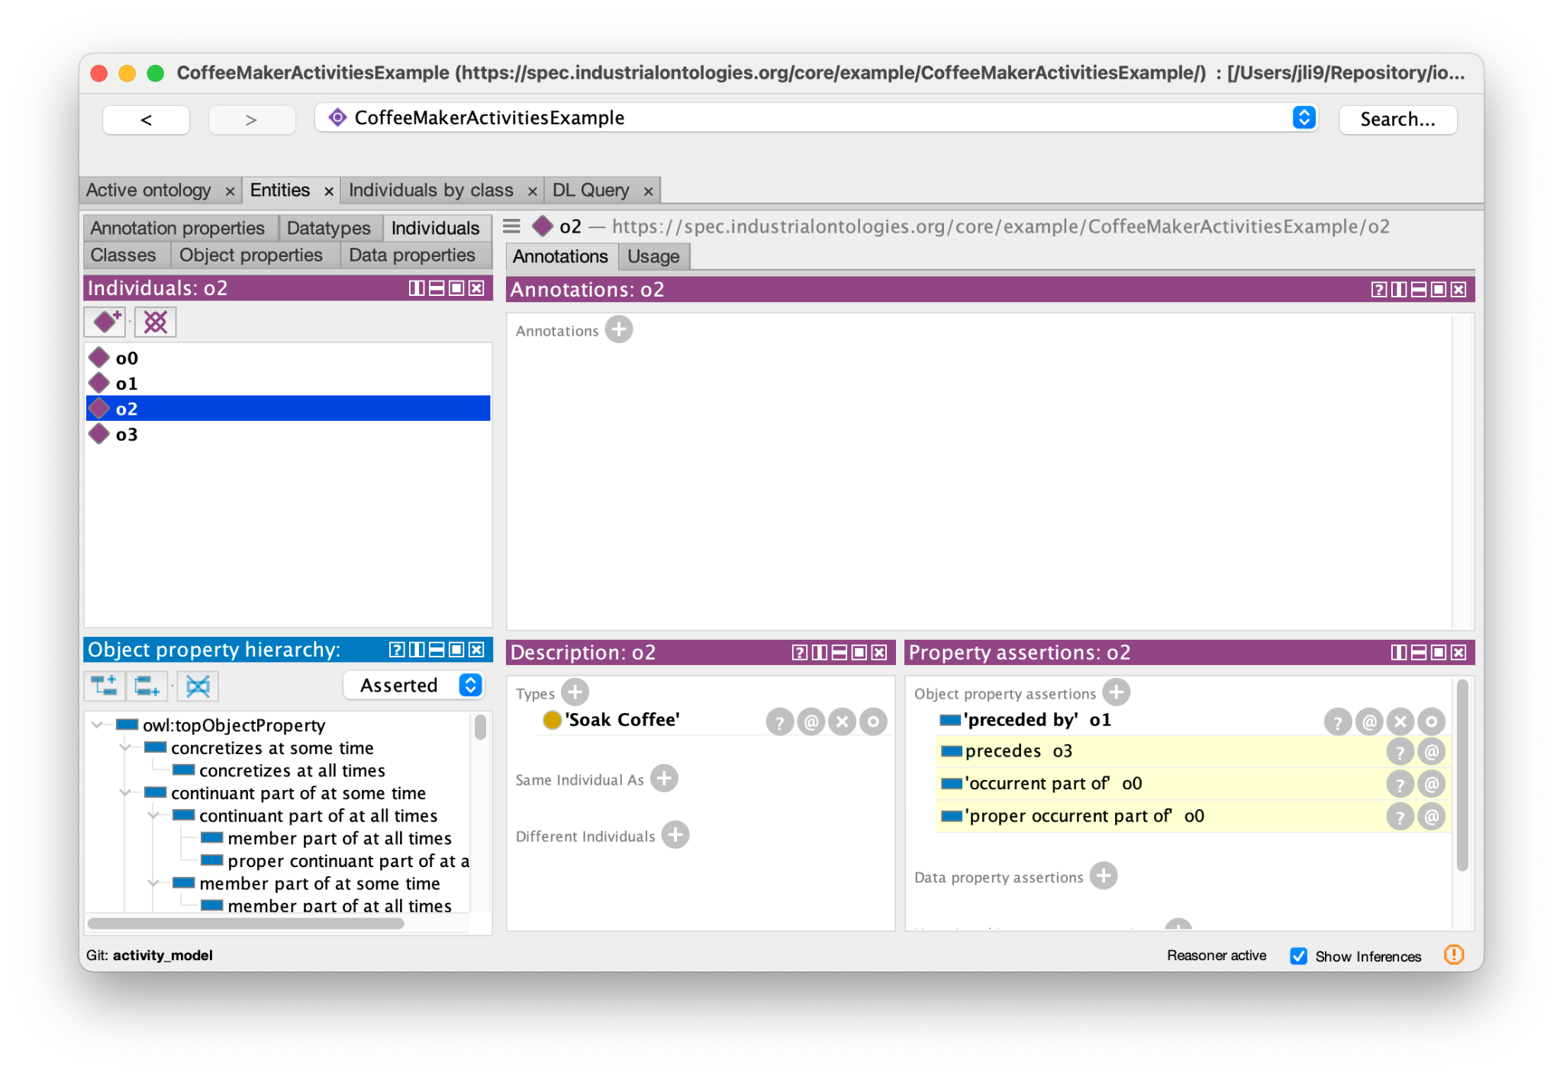
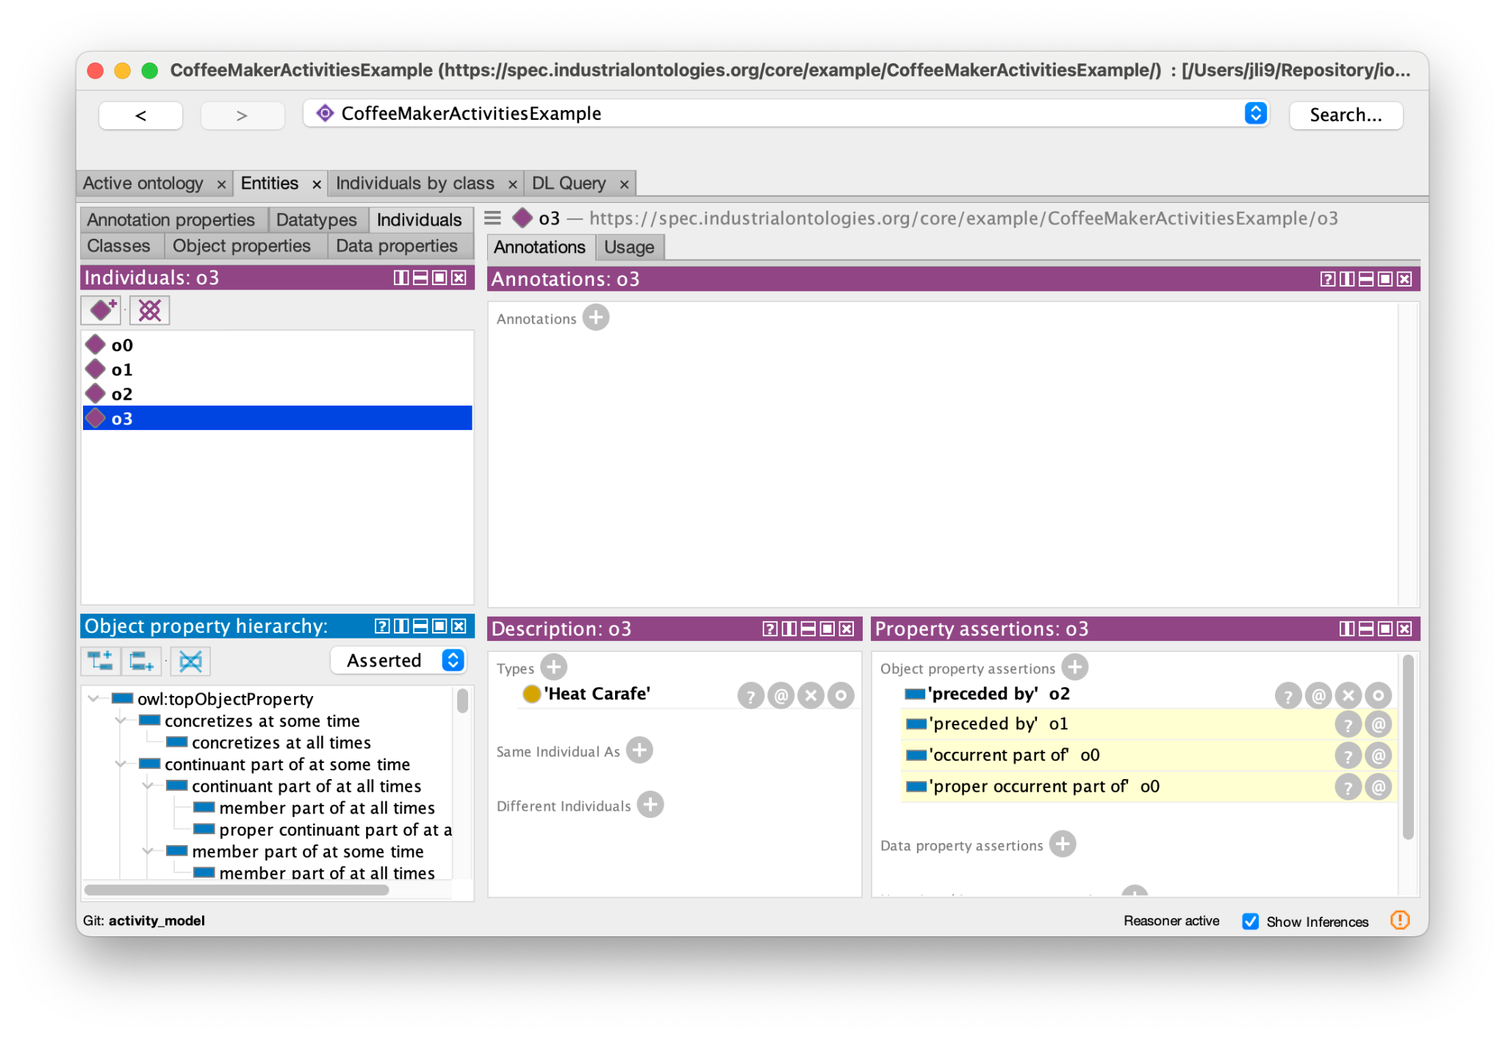
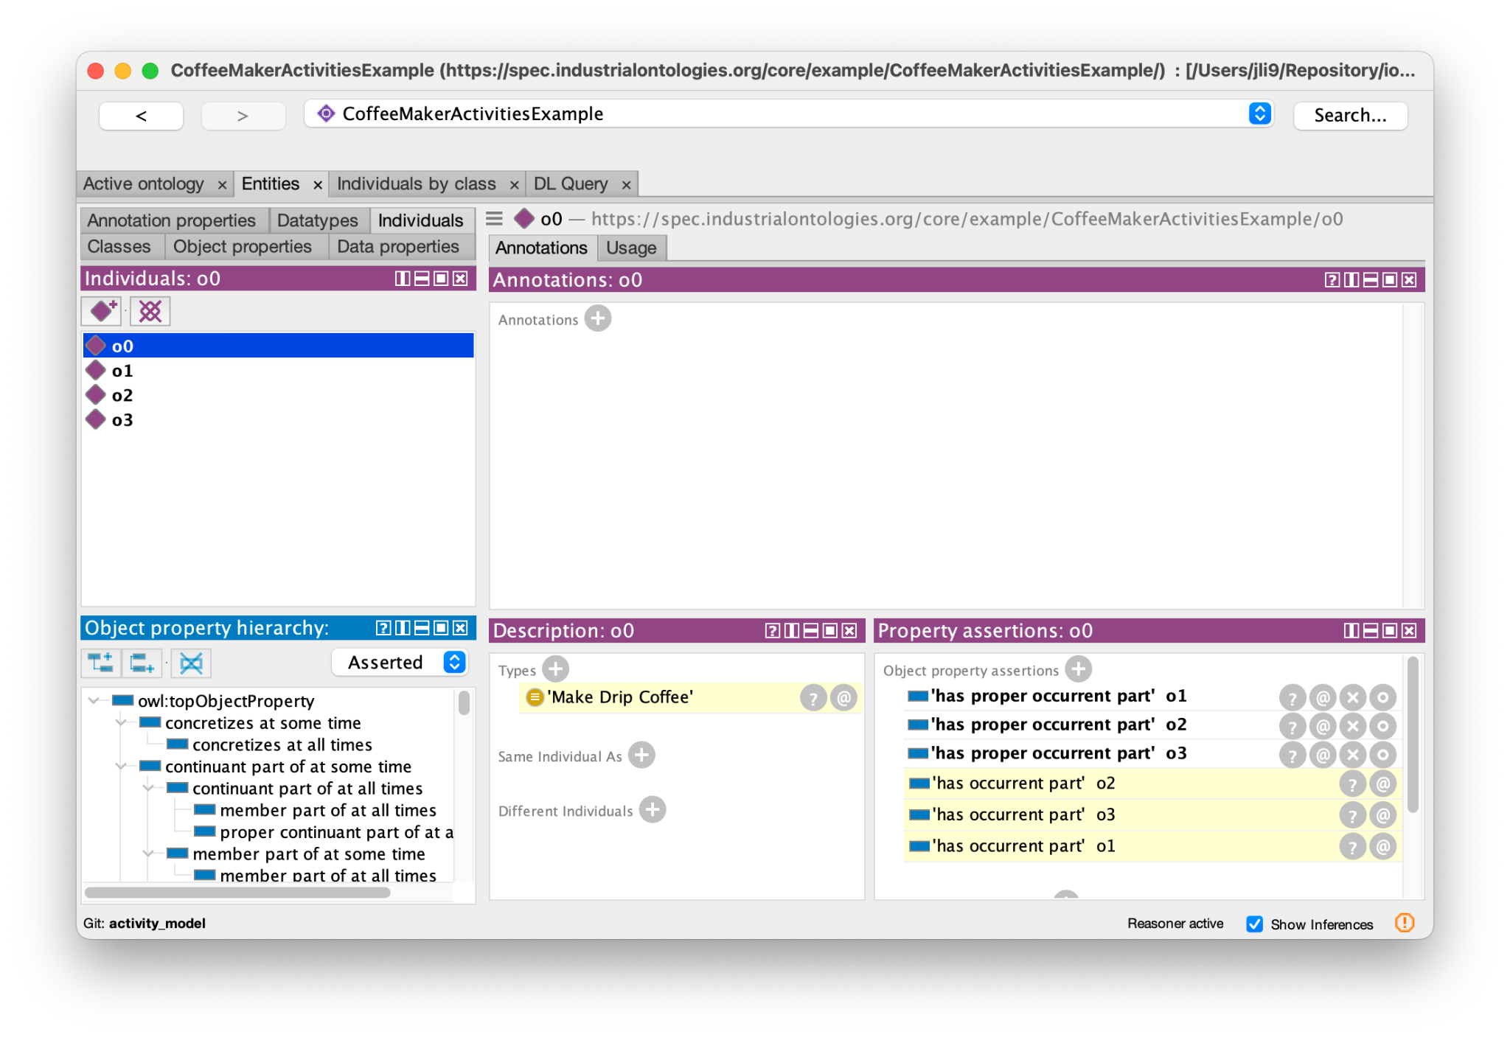
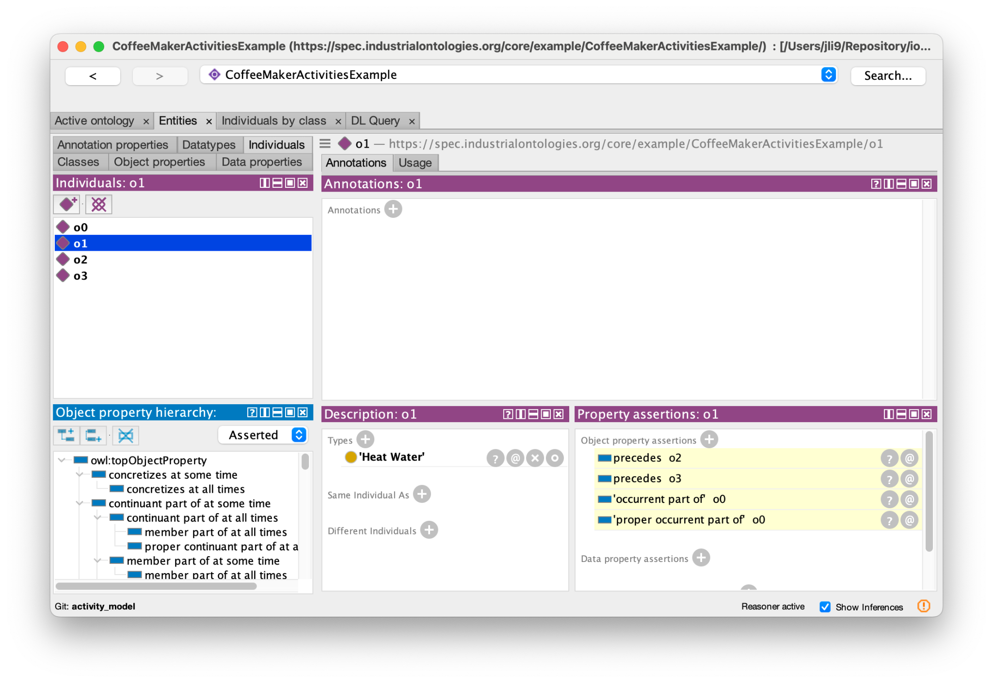
Additional assertions inferred by reasoner

Slide 12
Future work
Another possible approach is to represent an activity model as a ‘Plan Specification’:
The ‘Plan Specification’ could have a ‘specifies’ relationship with the kind of entity it specifies:
E.g., ‘Make Drip Coffee’ ‘specifies’ ‘process’
E.g., ‘2030 Toyota Camry’ ‘specifies’ ‘Vehicle’ (and ‘Material Artifact’)
Every valid instance of the kind of entity (e.g., ‘process’ or ‘Vehicle’) ‘conforms to’ the ‘Plan Specification’
No invalid instance ‘conforms to’ the ‘Plan Specification’
The approach to representing future plans needs to be harmonized with the Production Planning and Scheduling WG and the Systems Engineering WG
Arko has mapped all activity-model element types, so he will show a complex example

Slide 13
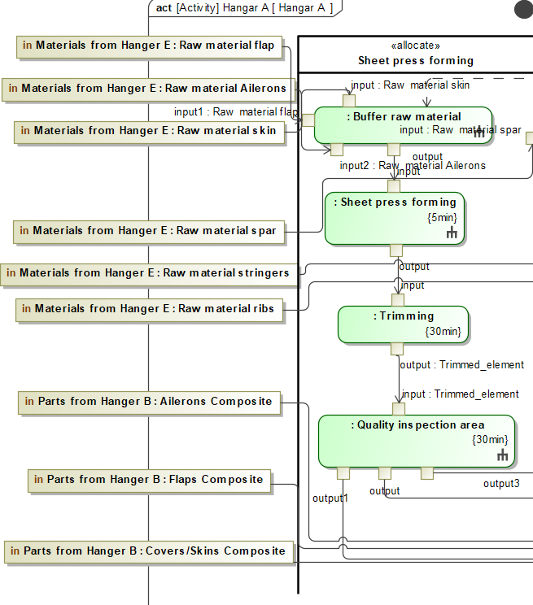
SysML Activity Diagram
Small part of a complex System design of Aircraft Production System captured in activity diagram.
We focus on only material flows among four activities: Buffer raw material, Sheet press forming, Trimming, and Quality Inspection.
Three types of materials are received by “Buffer raw material”.
every subsequent process receives a kind of material from previous process and produces output.
“Quality Inspection” produces three different types of materials.

Slide 14
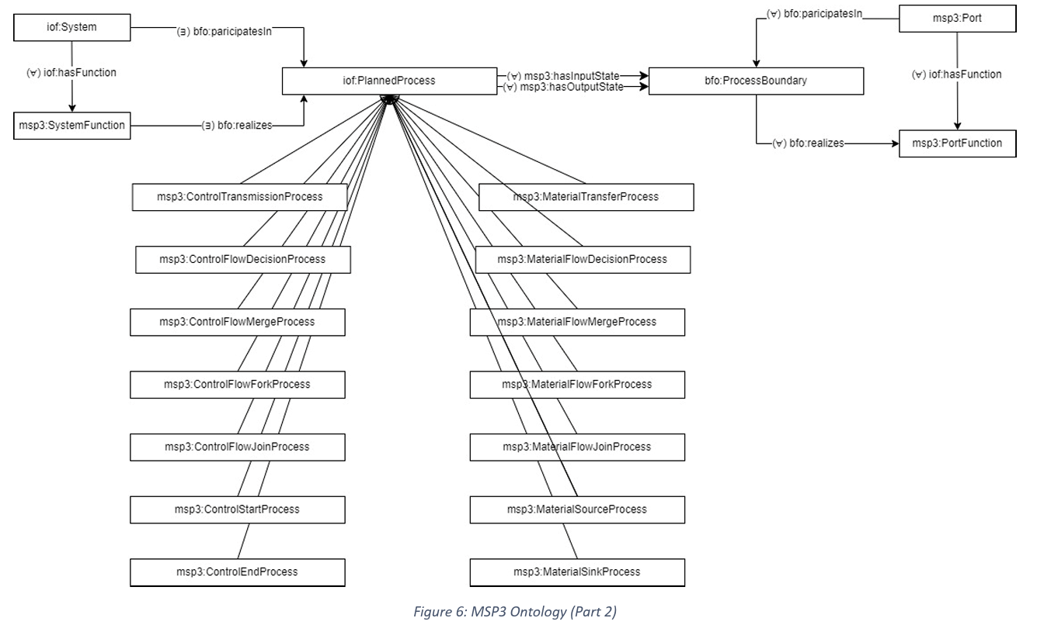
Ontology model

Slide 15
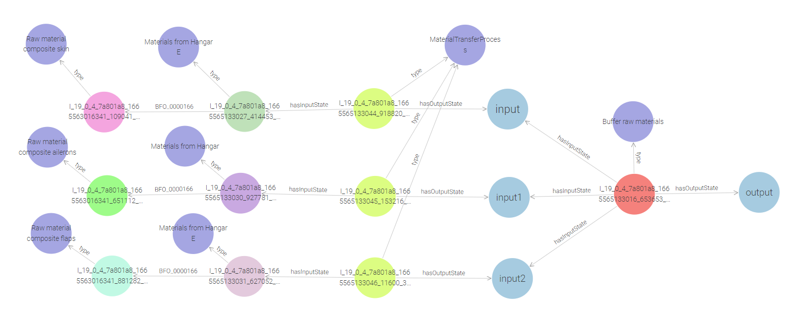
Material flow as input to a process

Slide 16
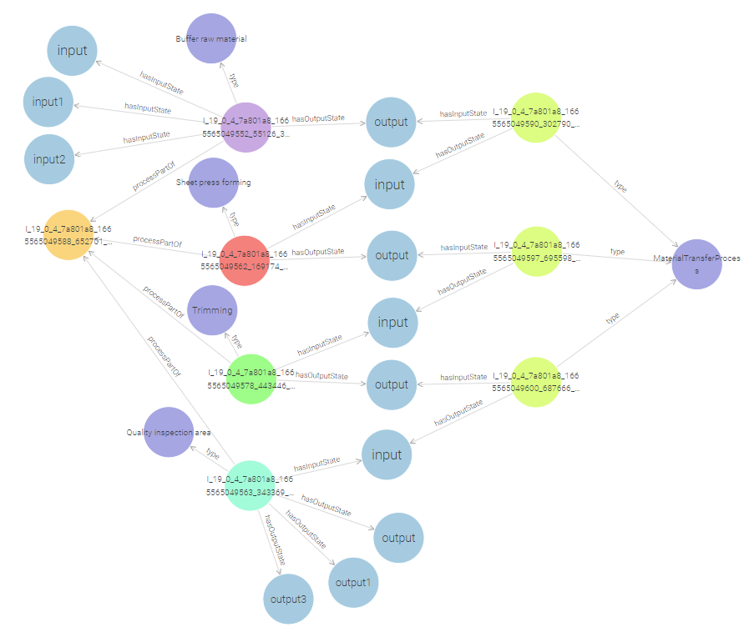
Process sequence and material flowing through

Slide 17
Questions and answers

