Slide 1
IOF SYSTEMS ENGINEERING WORKING GROUP
Annual Review
Jinzhi LU and Jim Logan
February 2024

Slide 2
Agenda
INTRODUCTION
RESULTS FROM LAST YEAR
WHAT’S NEXT
Summary

Slide 3
INTRODUCTION
Brief Background
Chartered in 2020 by Jinzhi Lu and Dimitrios Kyritsis
Goal: logically define systems-engineering notions defined in standards (e.g., from ISO, INCOSE, OMG)
Paused meetings for several months in early 2023
Restarted meetings when Jim Logan was nominated as co-chair

Slide 4
INTRODUCTION
Infrastructure
Confluence for meeting minutes, presentations, and discussion diagrams
IOF ontology viewer for review
GitHub for ontology version management

Slide 5
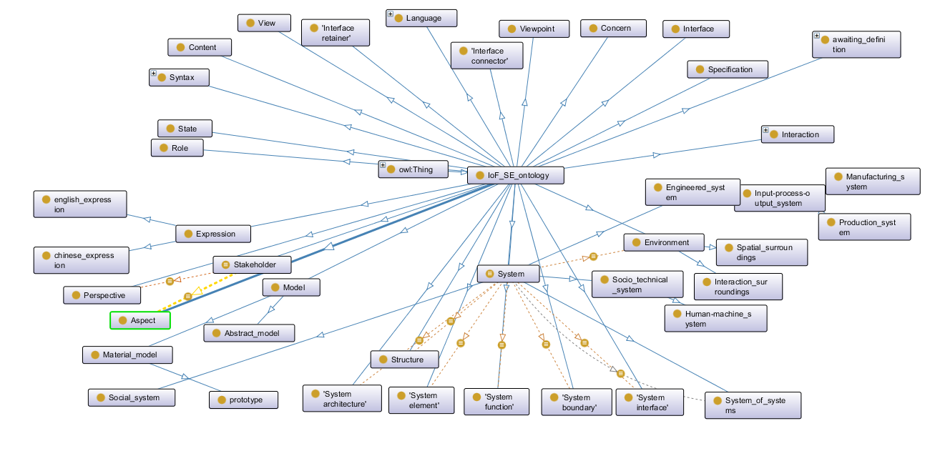
INTRODUCTION
86 Initial Notions in OWL

Slide 6
INTRODUCTION
Discussed Notions
System Lifecycle, Phase, Workflow
Architecture, System, System of Systems,
Model, Modeling Language
Environment, System Boundary, Interface, Function, Capability
Viewpoint, View
(Boldface indicates more recently discussed)

Slide 7
Results from last year
Let’s Dive In

Slide 8
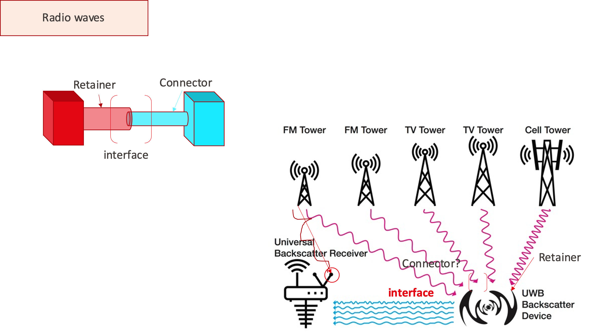
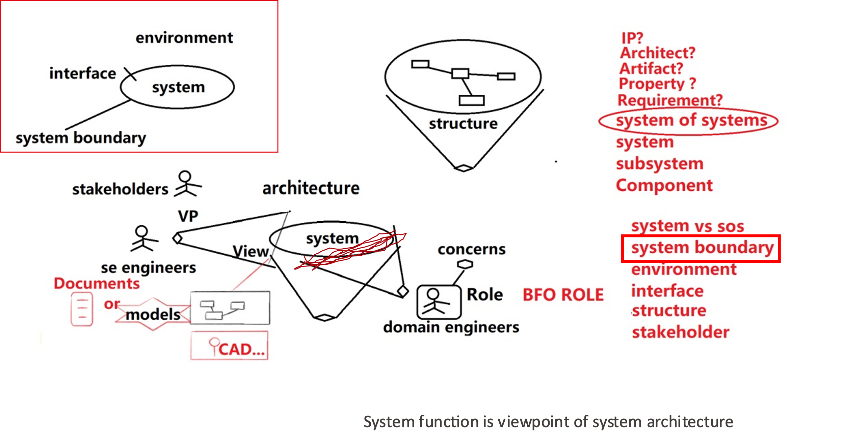
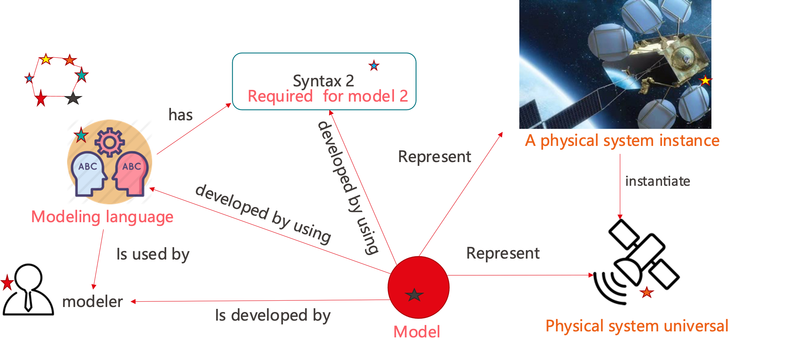
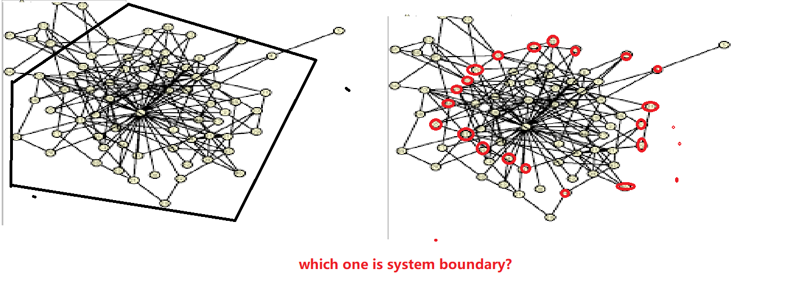
very rough consensus on definitions
Discussed using Powerpoint diagrams
Terms included:
Model, (Modeling) Language, Syntax

Slide 9
Preliminary Definitions
Model: Representation of an aspect of reality that is created to describe, explain, or predict the aspect of reality in question
Language: Method of human communication, consisting of symbols used in a structured and conventional way and conveyed by speech, writing, or gesture
Syntax: Rules that determine the arrangement of symbols in a sentence

Slide 10
Met with ACSI / UOF
ACSI := Alabama CubeSat Initiative
UOF := Unified Ontologies Foundry
Discussions with Dr. Michael Halvorson, ACSI Chief Engineer
Explained EMPIRE (Engineering Management Platform for Integration, Realization, and Execution)
Model-Based Project Management
Discussed overlap between our efforts
Raised BFO, IOF, and CCO concerns
See slides posted on 2023-09-06
Both sides expressed the desire to collaborate

Slide 11
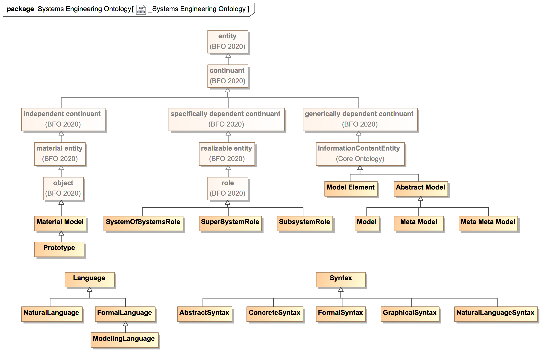
Established a Working OWL Ontology
Added an initial OWL ontology to a branch (“system-engineering-dev”) in the IOF GitHub repository
Contained 86 classes, 17 object properties, 29 annotation properties
See “SystemsEngineering.rdf”
Included the IOF Core and Annotations ontologies
Added configuration files for the IOF Viewer
Resolved hanging reasoners by moving aside all but recently-discussed terms
See “RawSystemsEngineering.rdf”

Slide 12
Reset our Process
Discussed the new IOF process
Refined our goals:
Augment other modeling languages (e.g., SysML)
Link systems-engineering notions to other disciplines (e.g., materials science, supply chain, and production planning and scheduling)
At this summit, we would like to:
Elicit and document business problems
Define some “epic user stories” and use cases

Slide 13
What’s next
LOOKING AHEAD

Slide 14
Plan for 2024
Follow the IOF process more closely
Elicit and document business problems, use cases, and epic user stories
Break down epics into smaller user stories
Prioritize terms based on user stories
Collaborate
Work with the PPS WG on the design of future things and on digital twins
Possibly work with ACSI / UOF
Release a version of the Systems Engineering OWL ontology by Q4 of 2024
Focus on terms supporting user stories
Reach consensus on how to ontologize those terms
Axiomatize those terms in OWL using existing properties
Add IOF-required annotations (e.g., FOL axioms, definitions, sources)
Pass hygiene tests
Write a white paper for INCOSE that documents our progress

Slide 15
Summary
Systems Engineering Ontology
After good progress in 2024, follow the IOF process more closely and release this year.
Collaboration
Continue working with the PPS WG and ACSI / UOF.
Communication
Write a white paper for INCOSE.

Slide 16
THANK YOU
Jinzhi LU and Jim Logan, iof se wg Co-chairs
https://oagi.org/pages/Systems-Engineering-Working-Group

